Slide 1
Composition, Light & Posing
The creative stuff

Slide 2
Composition

Slide 3
Rule of Thirds
Draw an imaginary grid in your frame and divide it into 3 columns and 3 rows. Place important elements of the scene where the lines intersect.

Slide 4
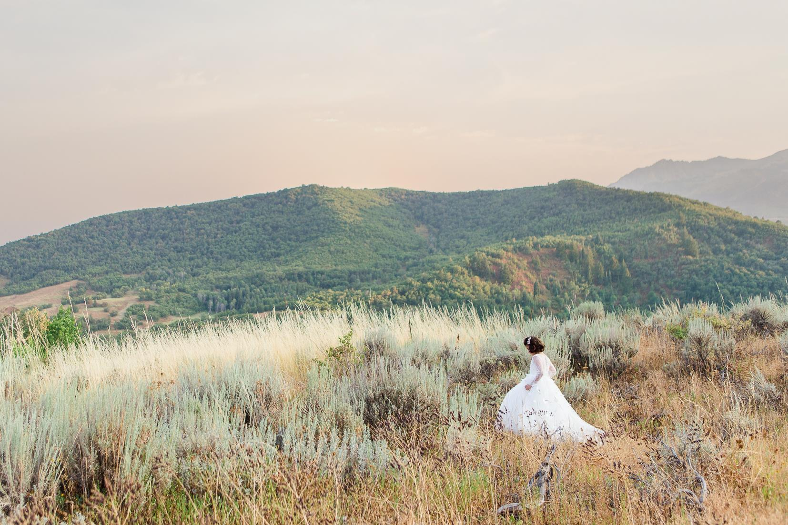

Slide 5
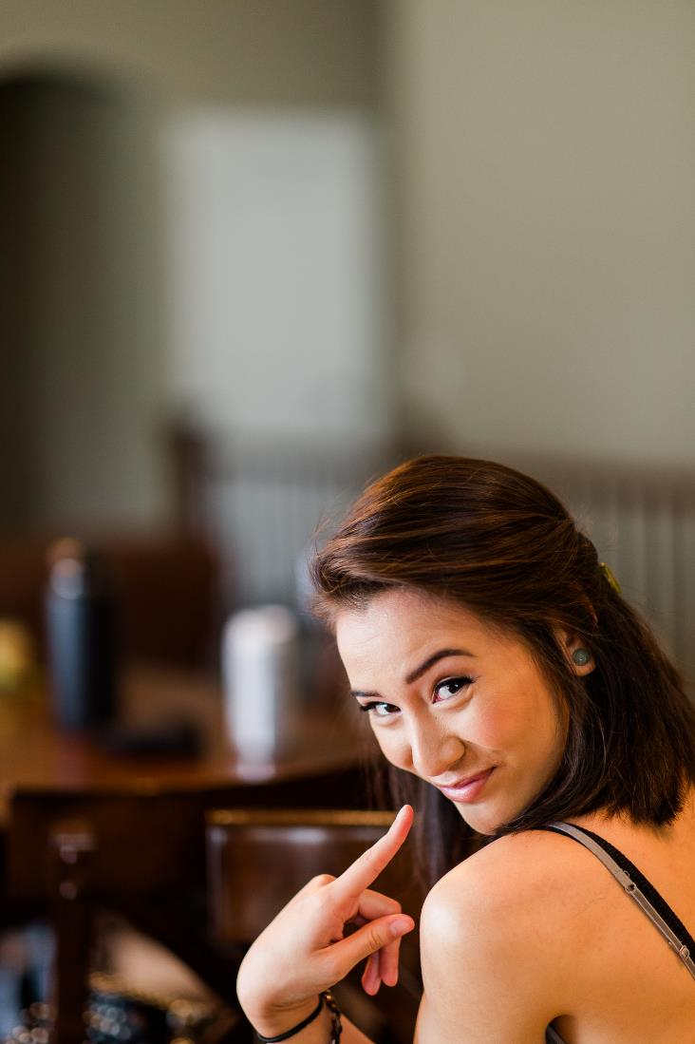

Slide 6
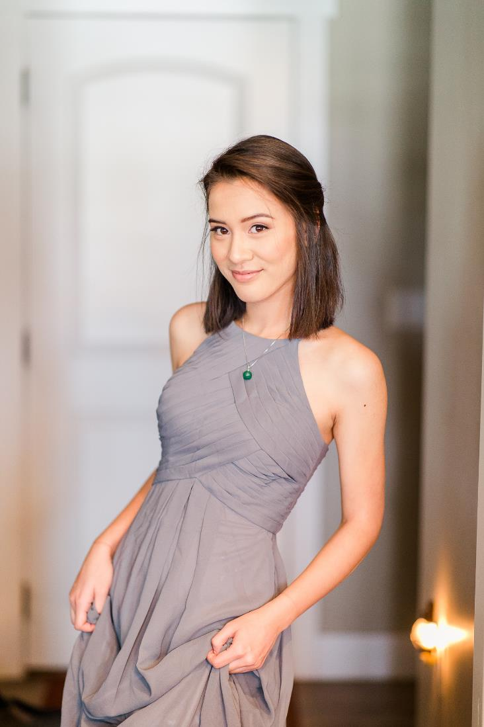

Slide 7
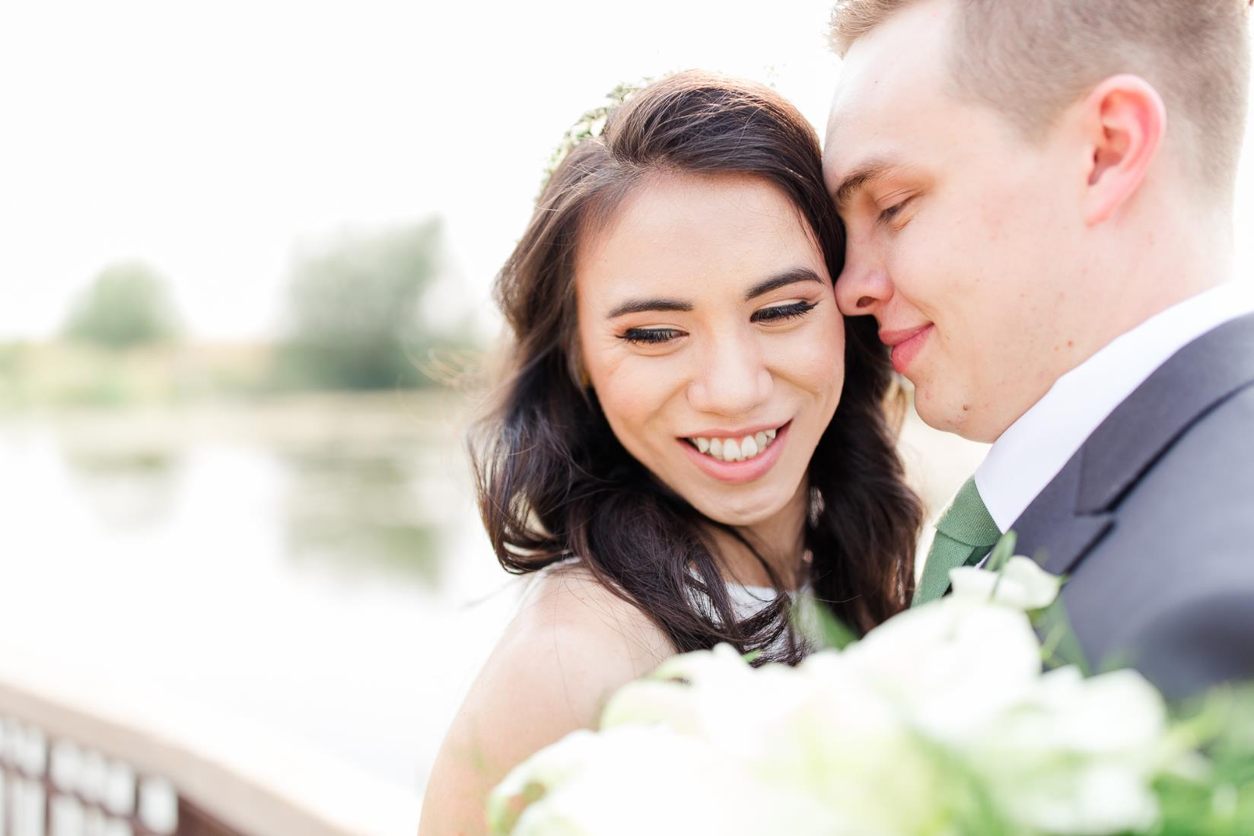

Slide 8
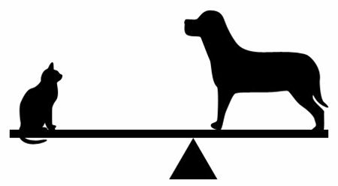
Symmetry & Balance
Balance in design is similar to balance in physics. A large shape close to the center can be balanced by a small shape close to the edge. Balance provides stability and structure to a design. It’s the weight distributed in the design by the placement of your elements.

Slide 9
Balance
Symmetrical
Asymmetrical

Slide 11
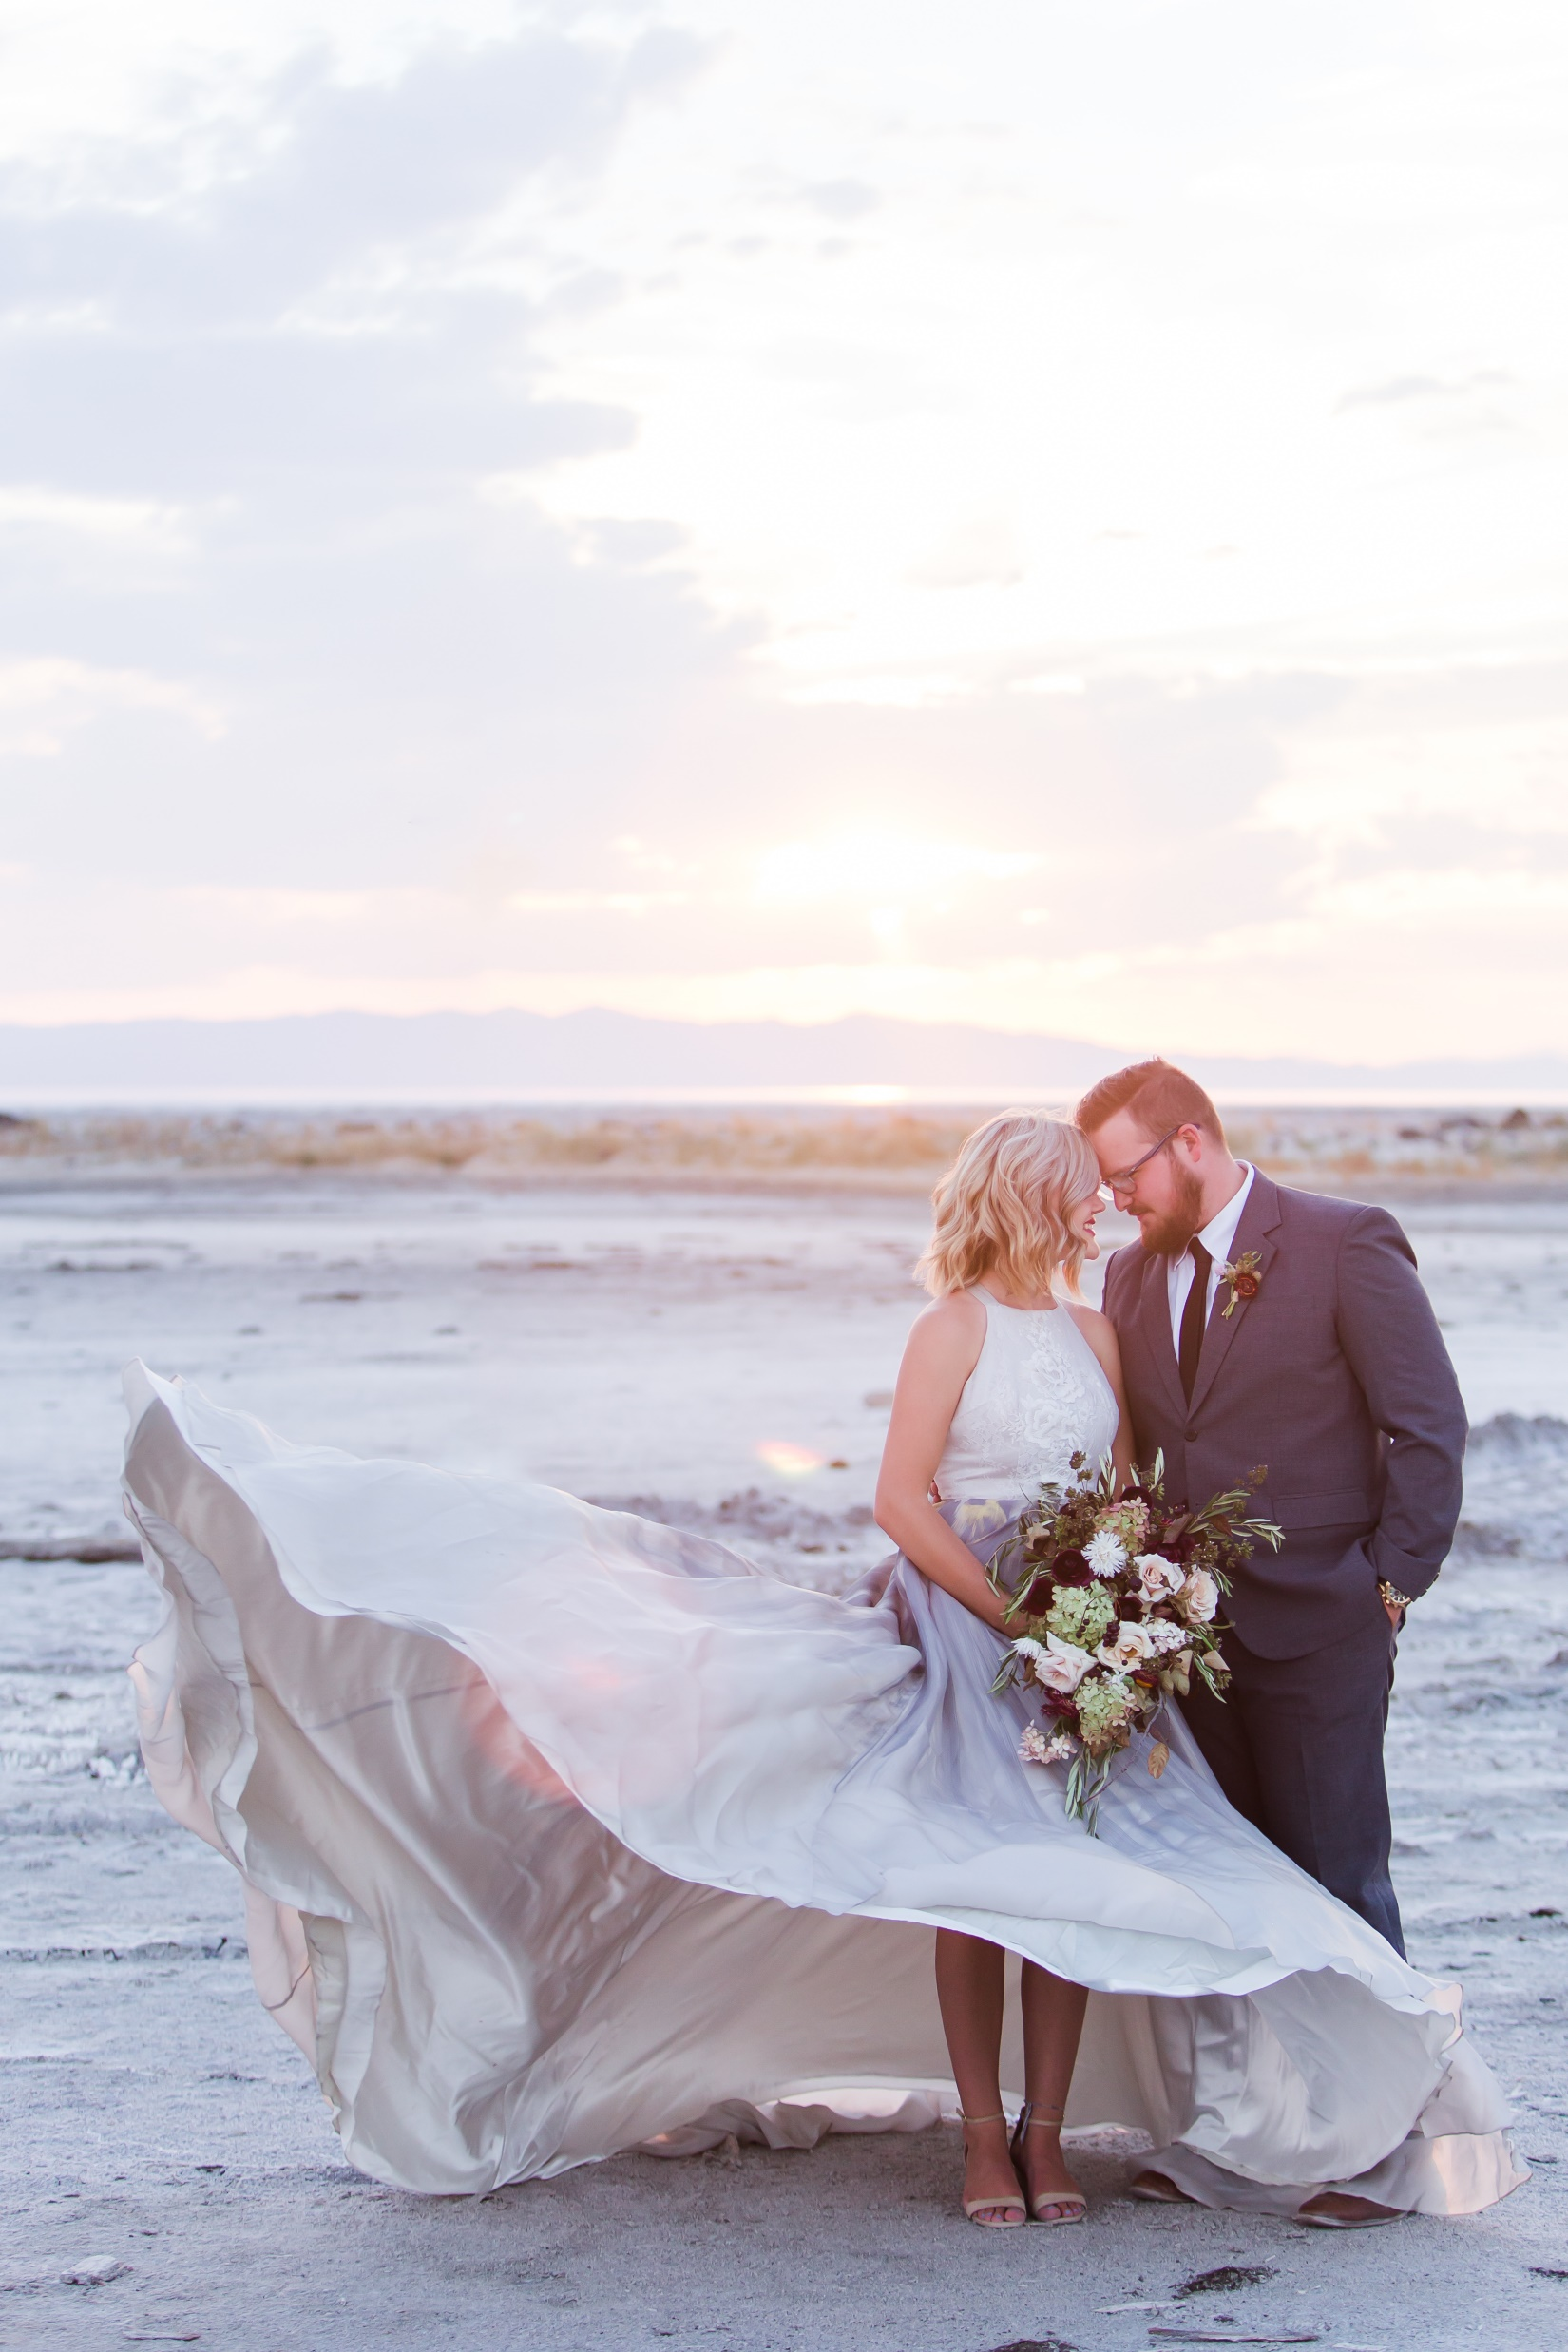

Slide 12
Depth & Layering
Because a photo is a two-dimensional object conveying an image of a 3D world, use backgrounds and foregrounds that convey a sense of depth.
You can also use shallow apertures to convey depth

Slide 13
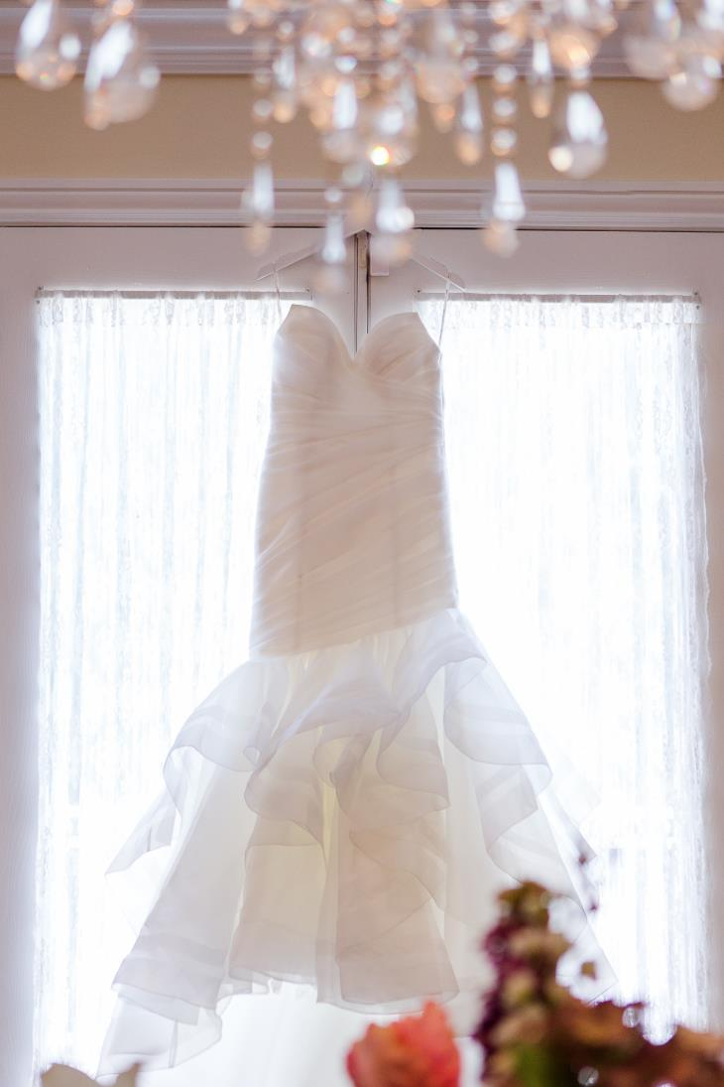

Slide 14
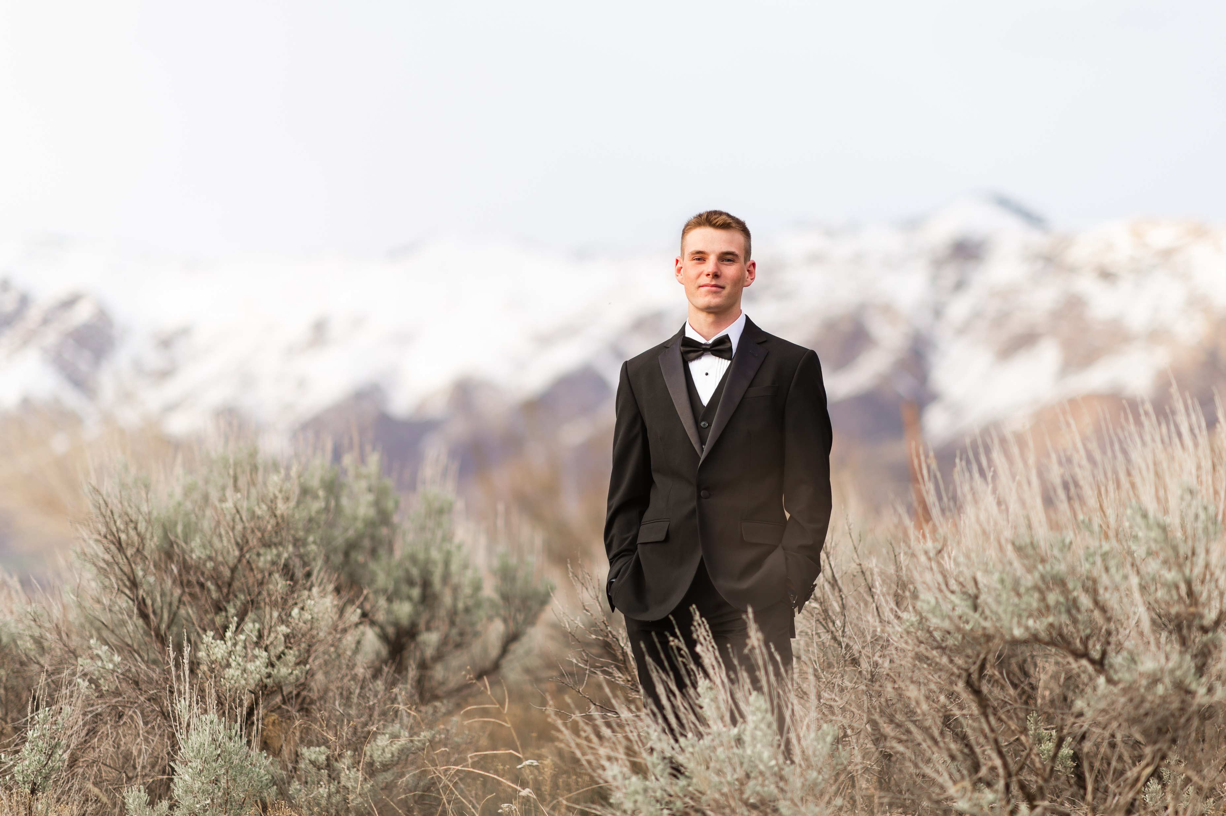

Slide 15
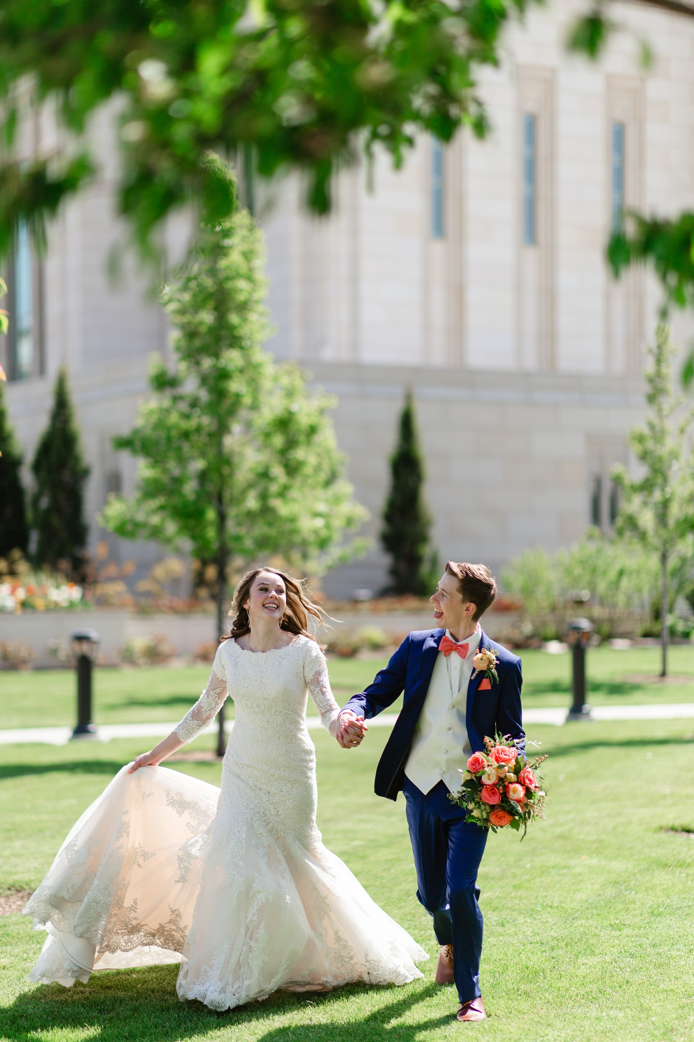

Slide 16
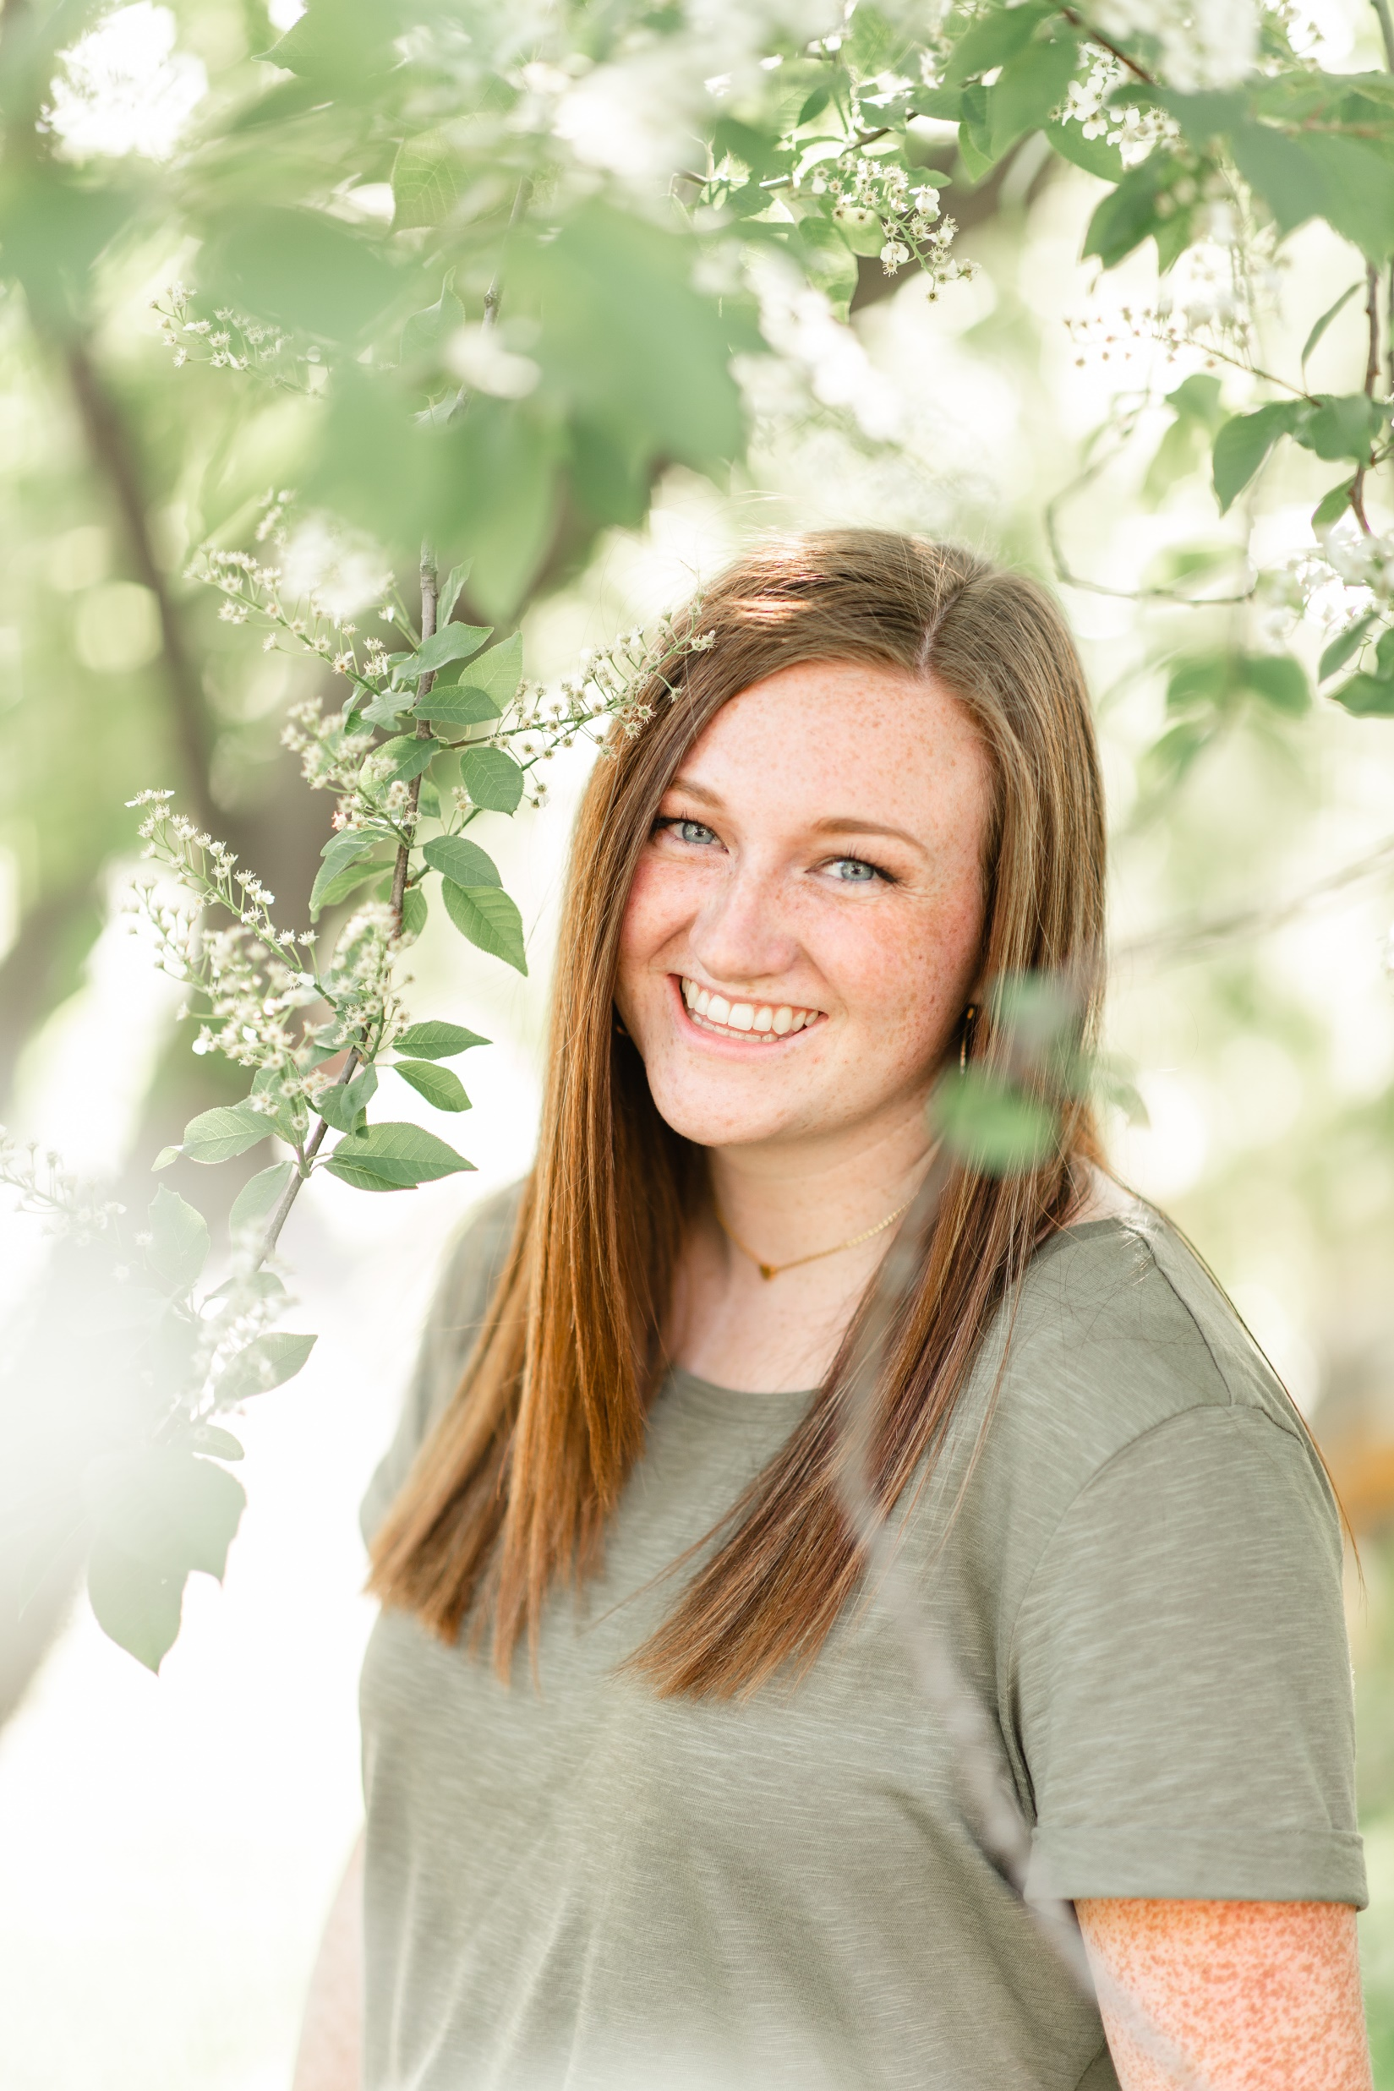

Slide 17
Framing
Use elements you see around you to frame your subject
Tree branches
Windows
Buildings
Walkways
Arches
Bushes

Slide 18
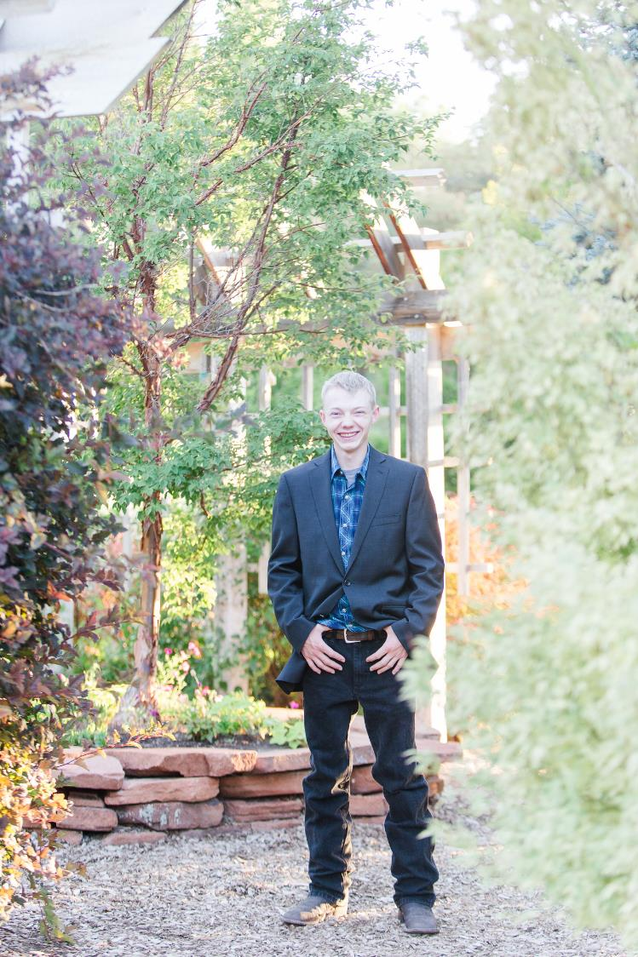

Slide 19
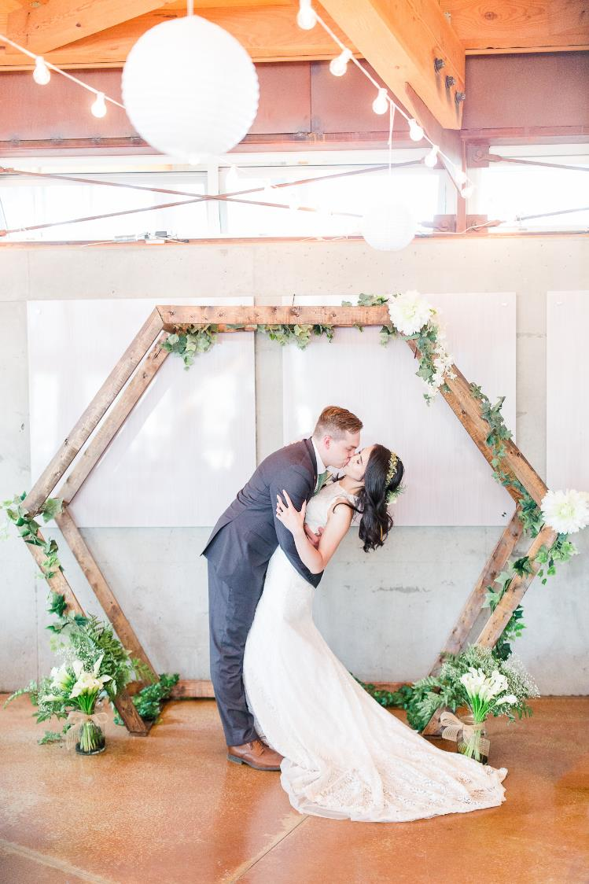

Slide 20
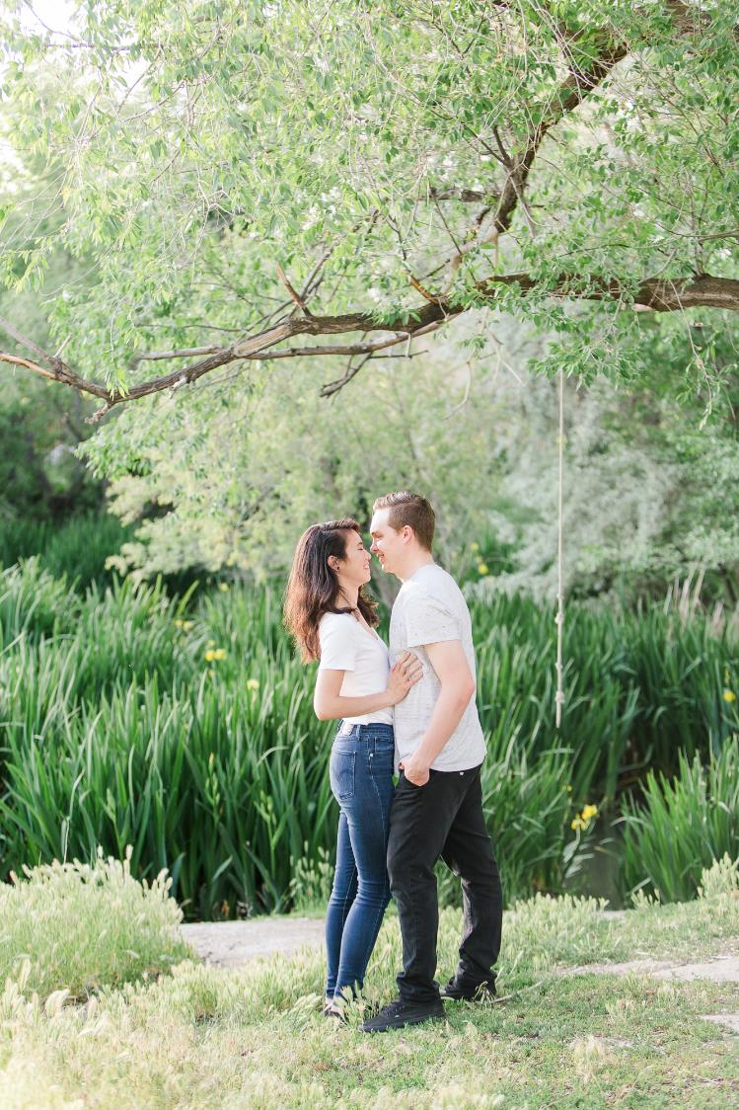

Slide 21
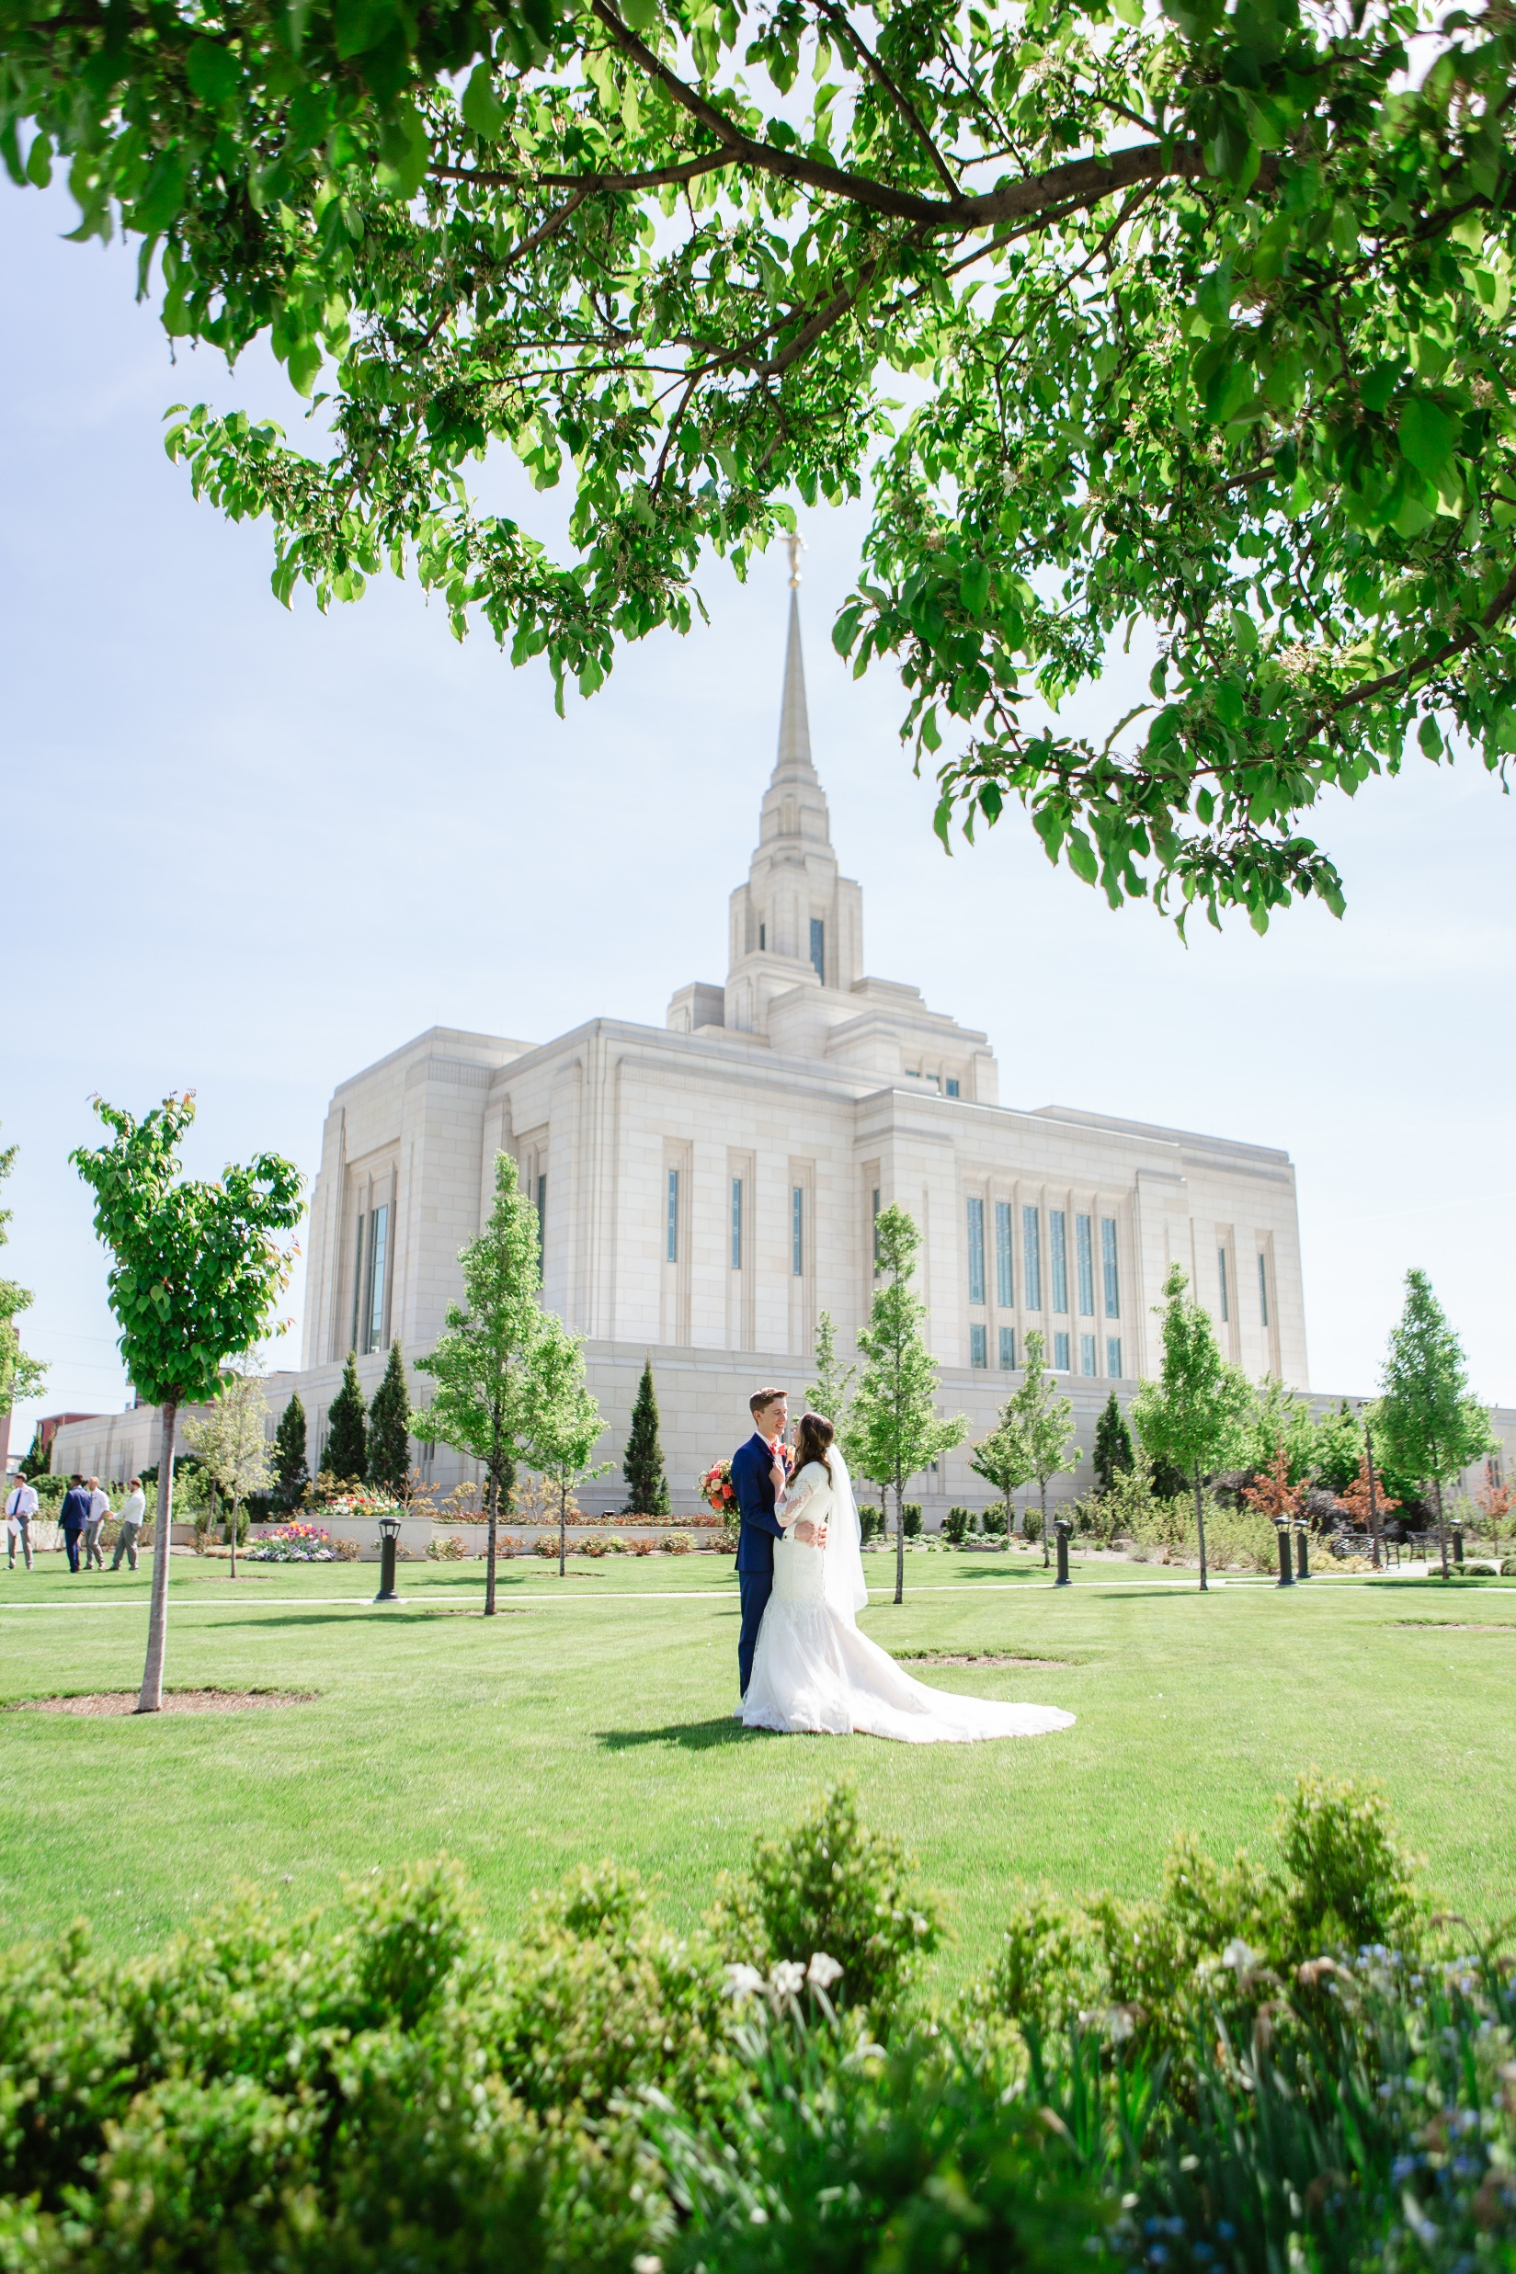

Slide 22
Leading Lines
Find strong lines in natural elements to lead the eye through the frame or to a subject

Slide 23
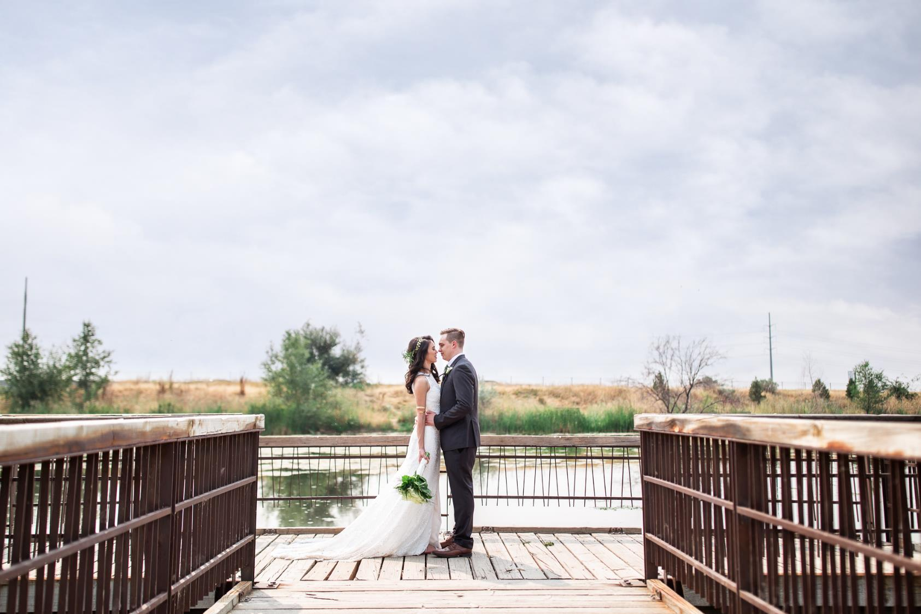

Slide 24
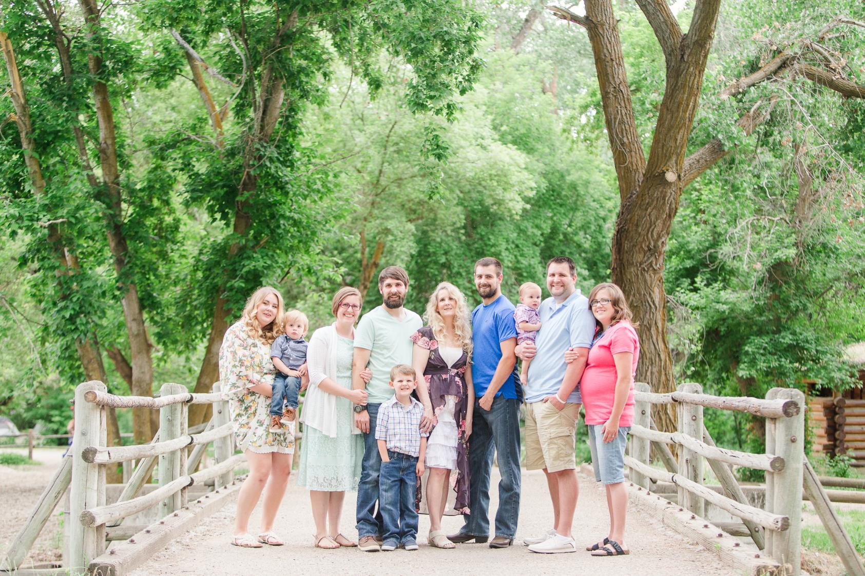

Slide 25
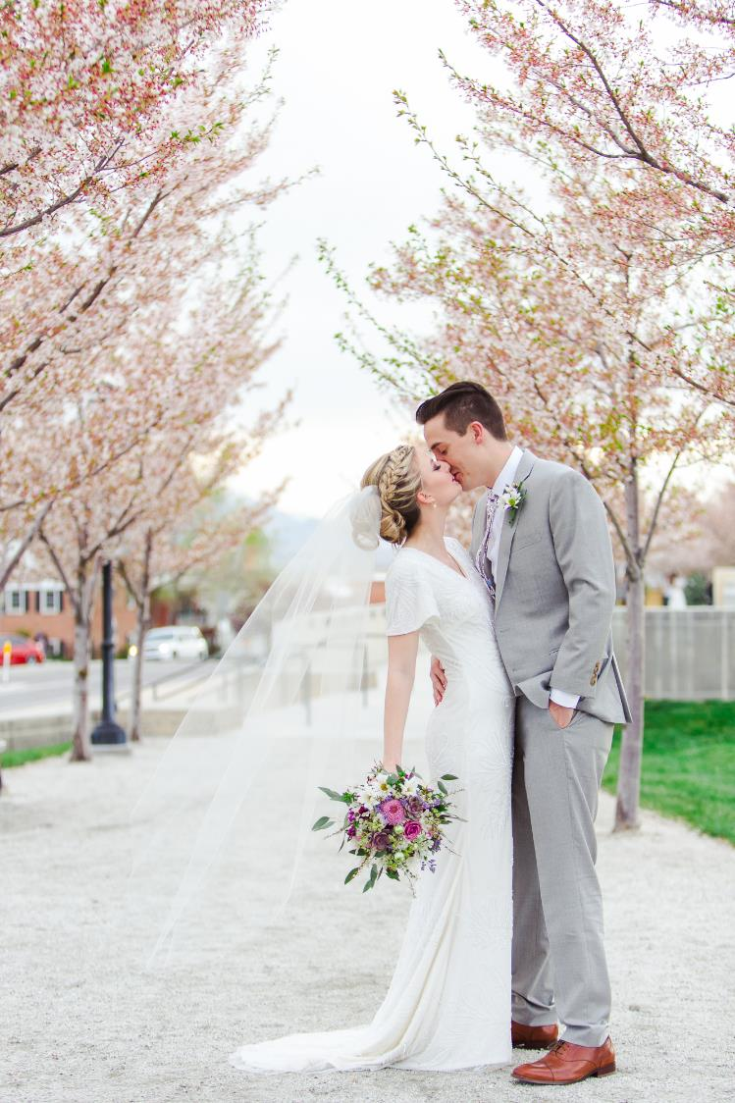

Slide 26
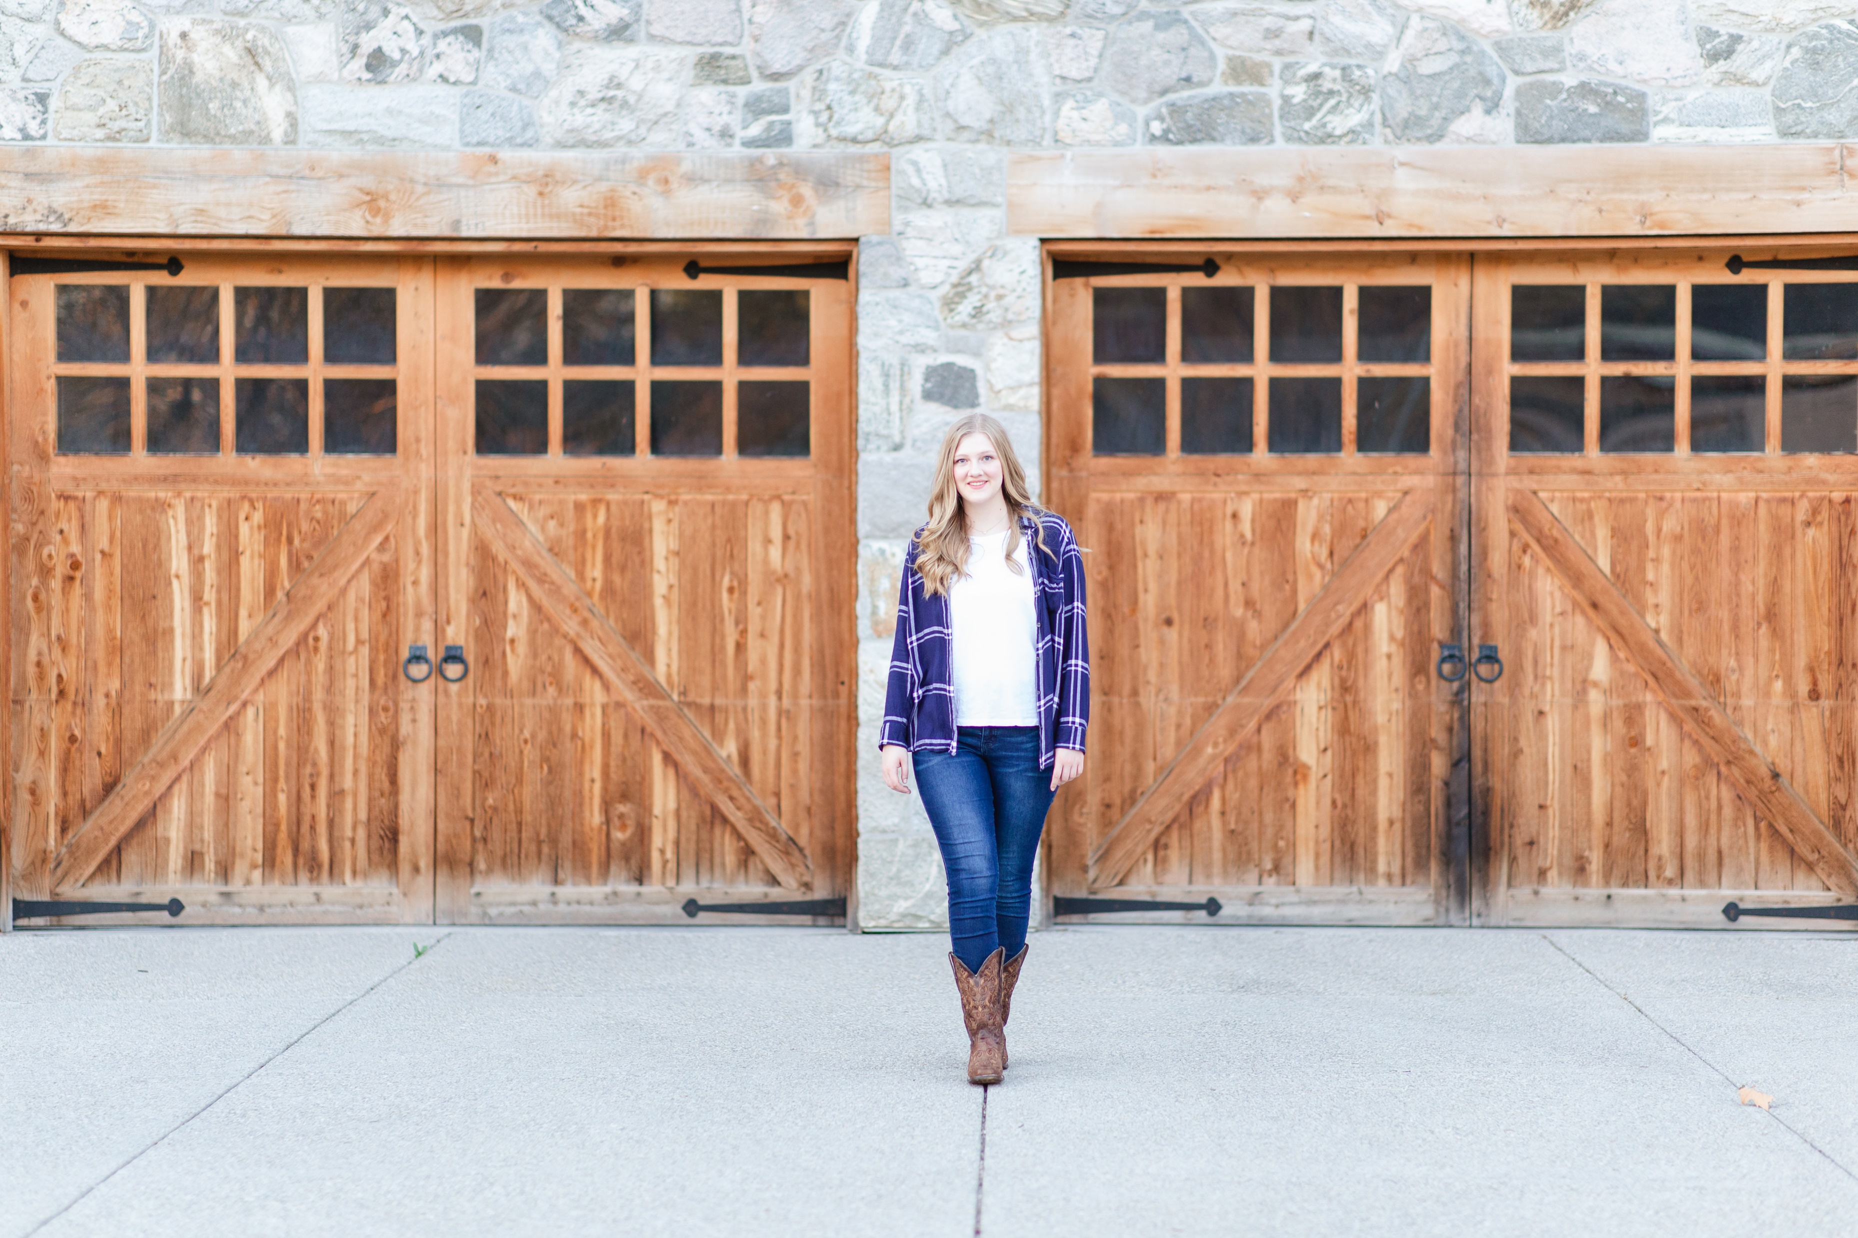

Slide 27
Negative Space
Creates a sense of simplicity and minimalism and peace.
Allows viewer to focus on subject.
Makes subject more powerful.

Slide 28
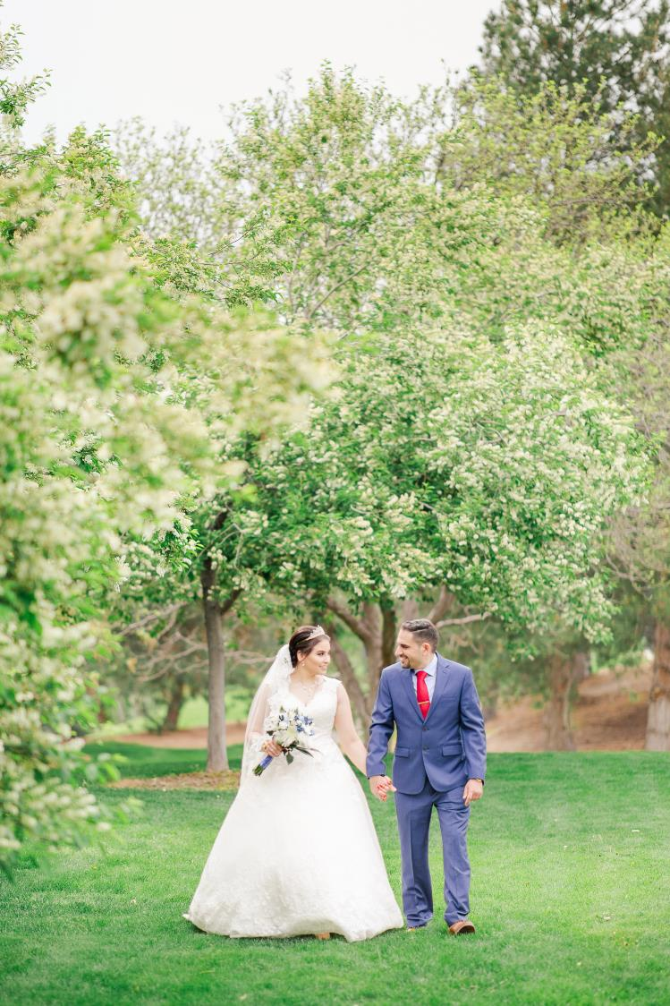

Slide 29
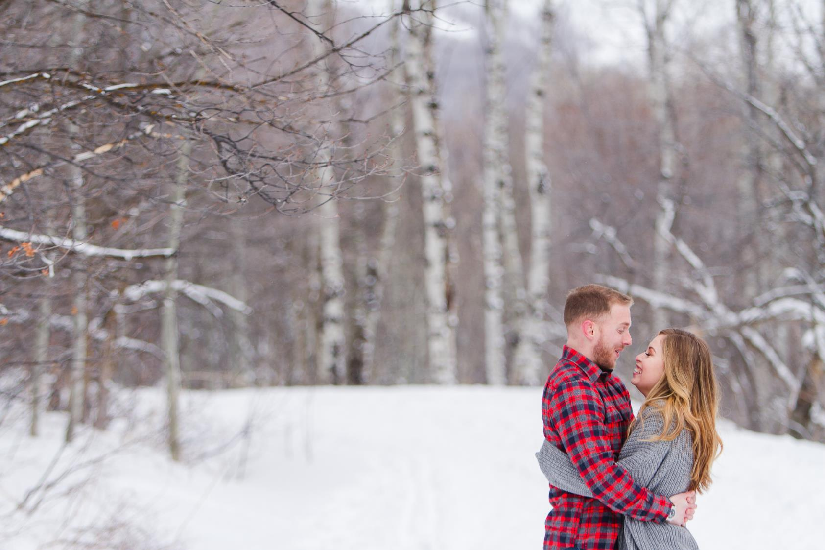

Slide 30
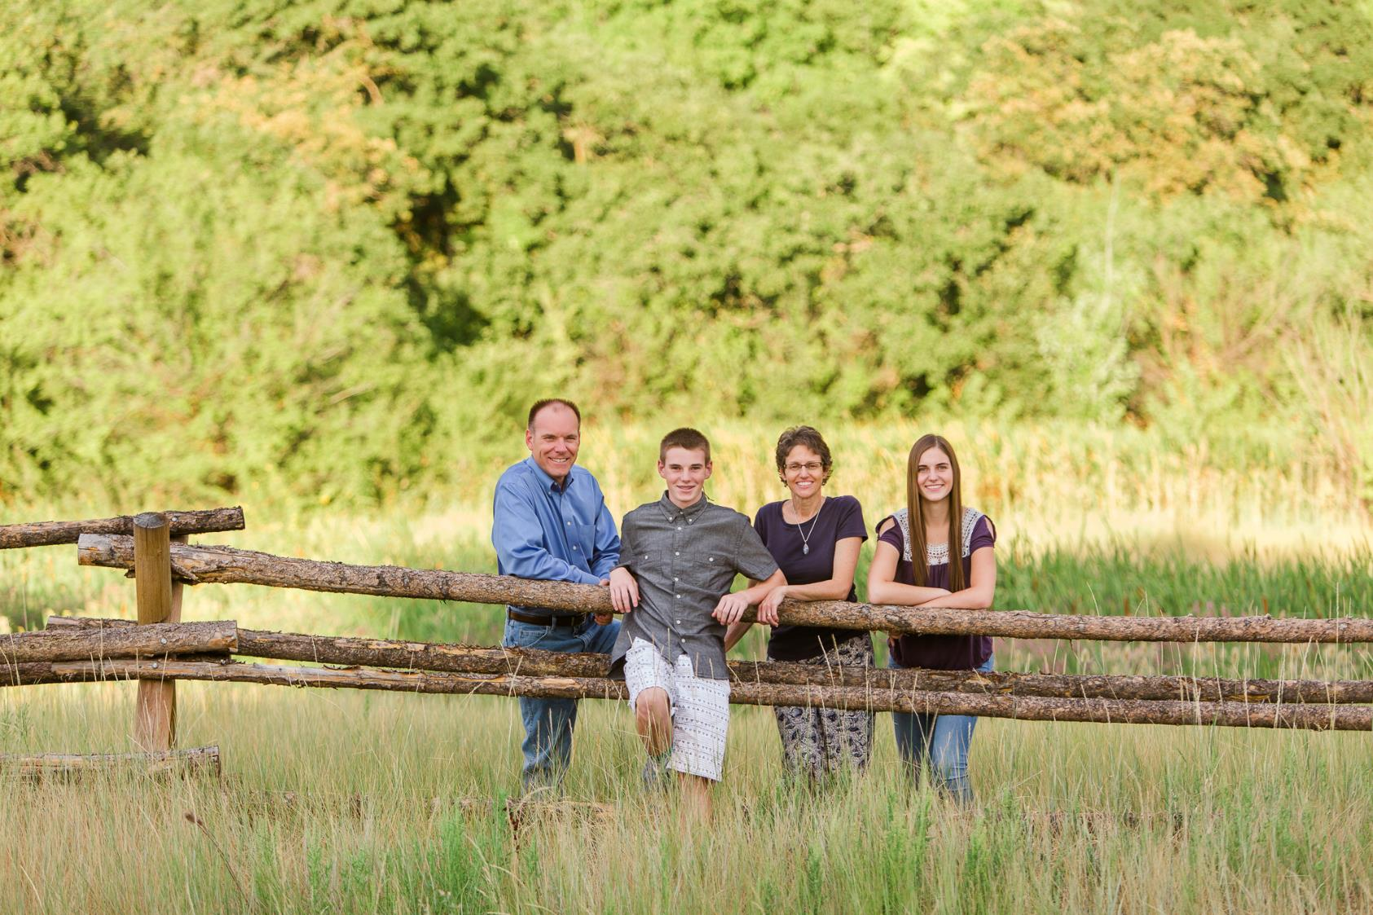

Slide 31
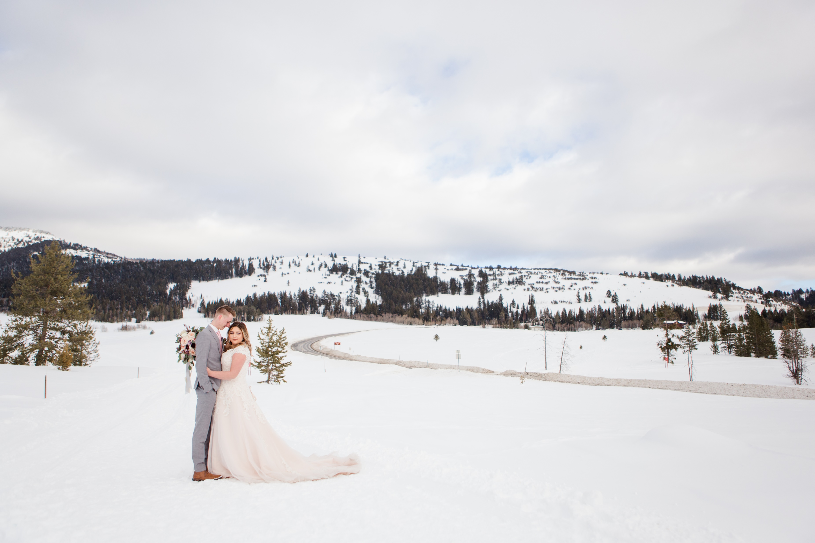

Slide 32
Simplify
Remove distracting elements
Crop out distracting elements
Use shallow depth of field

Slide 33
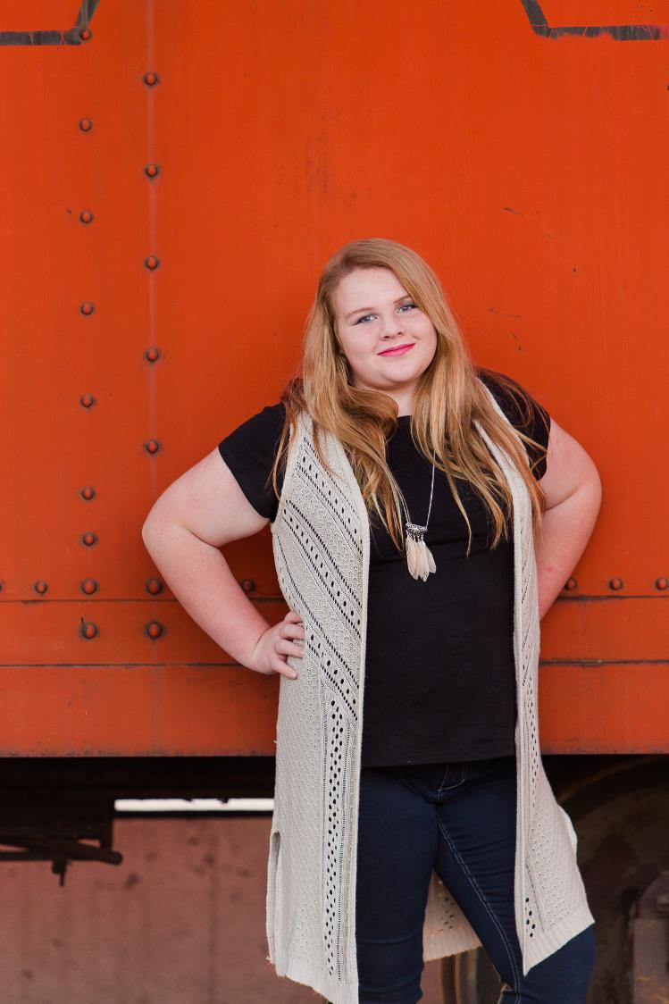

Slide 34
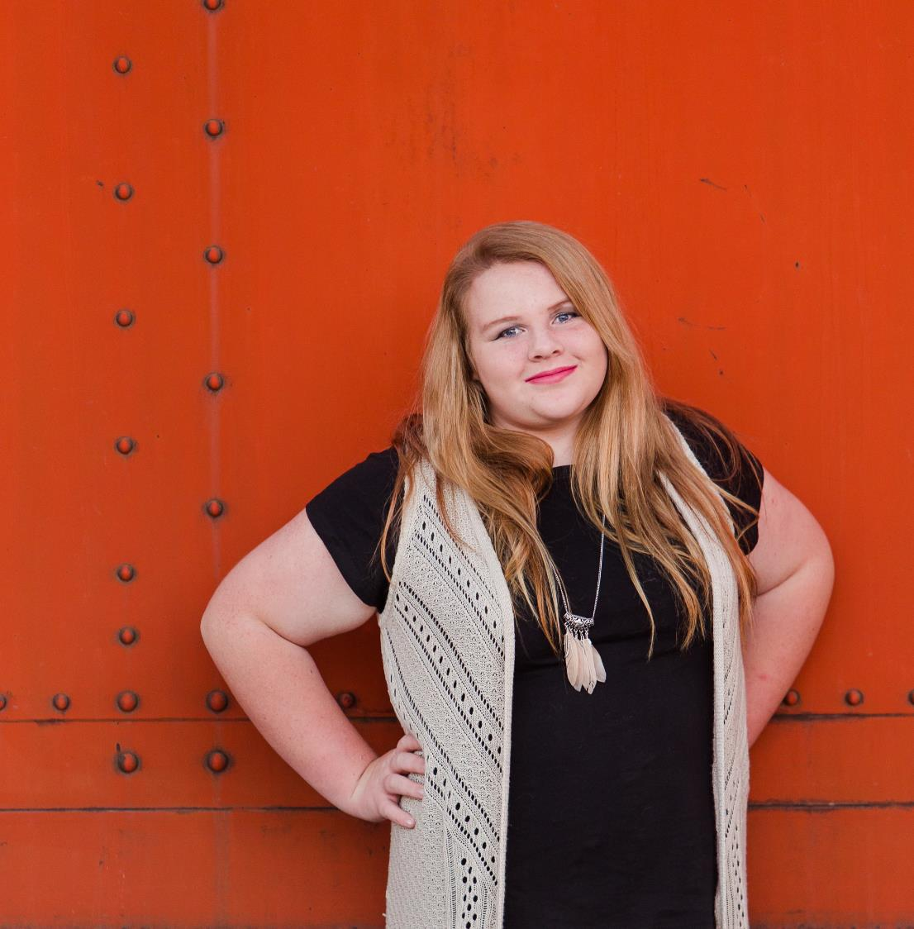

Slide 35
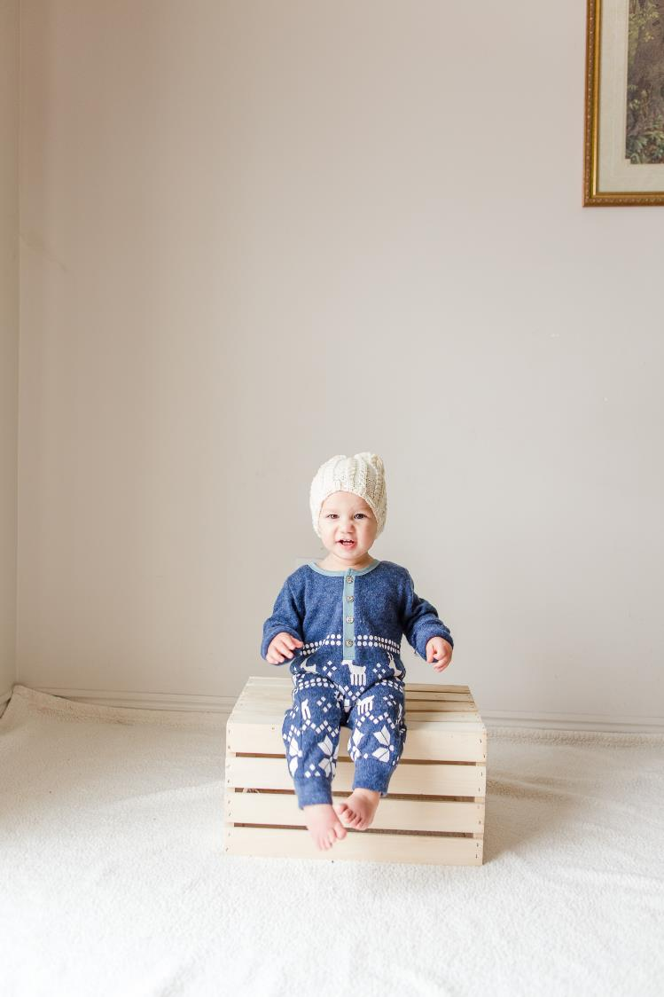

Slide 36
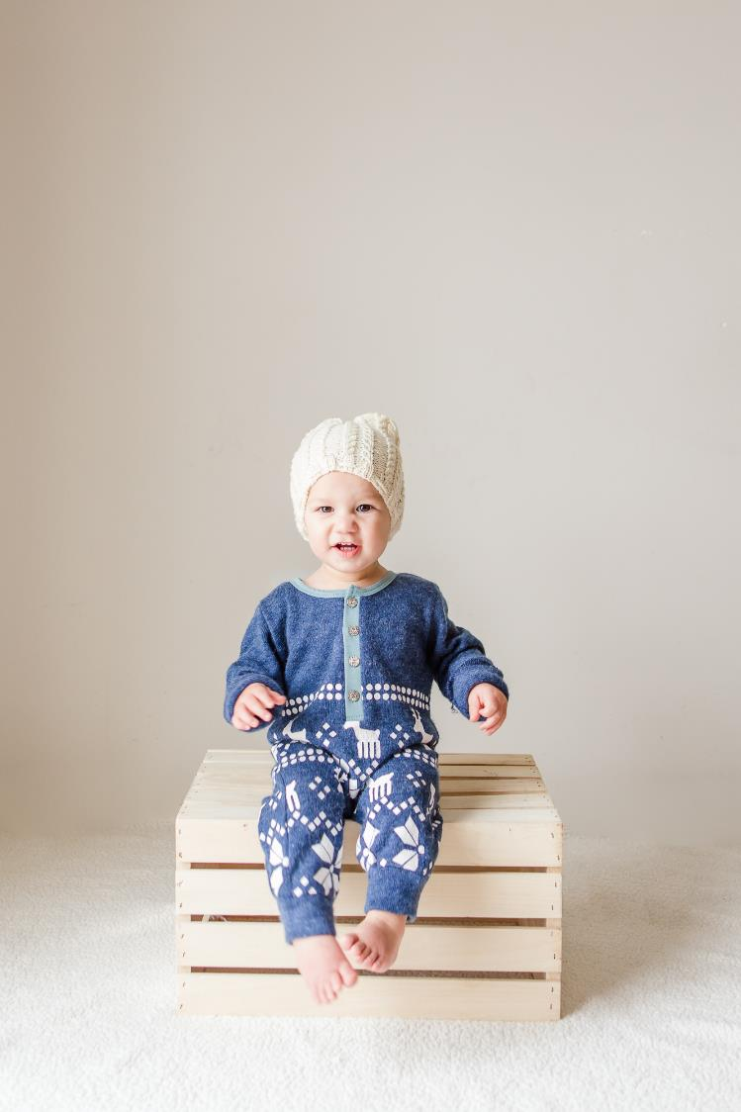

Slide 37
Fill the Frame
Don’t be afraid to get in close to your subject.
Gives an element of mystery
Helps get rid of distractions

Slide 39
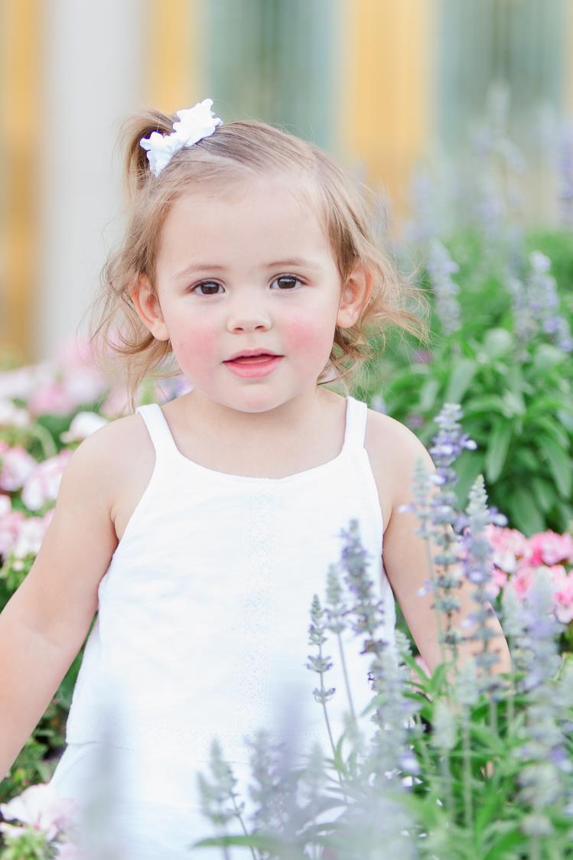

Slide 40
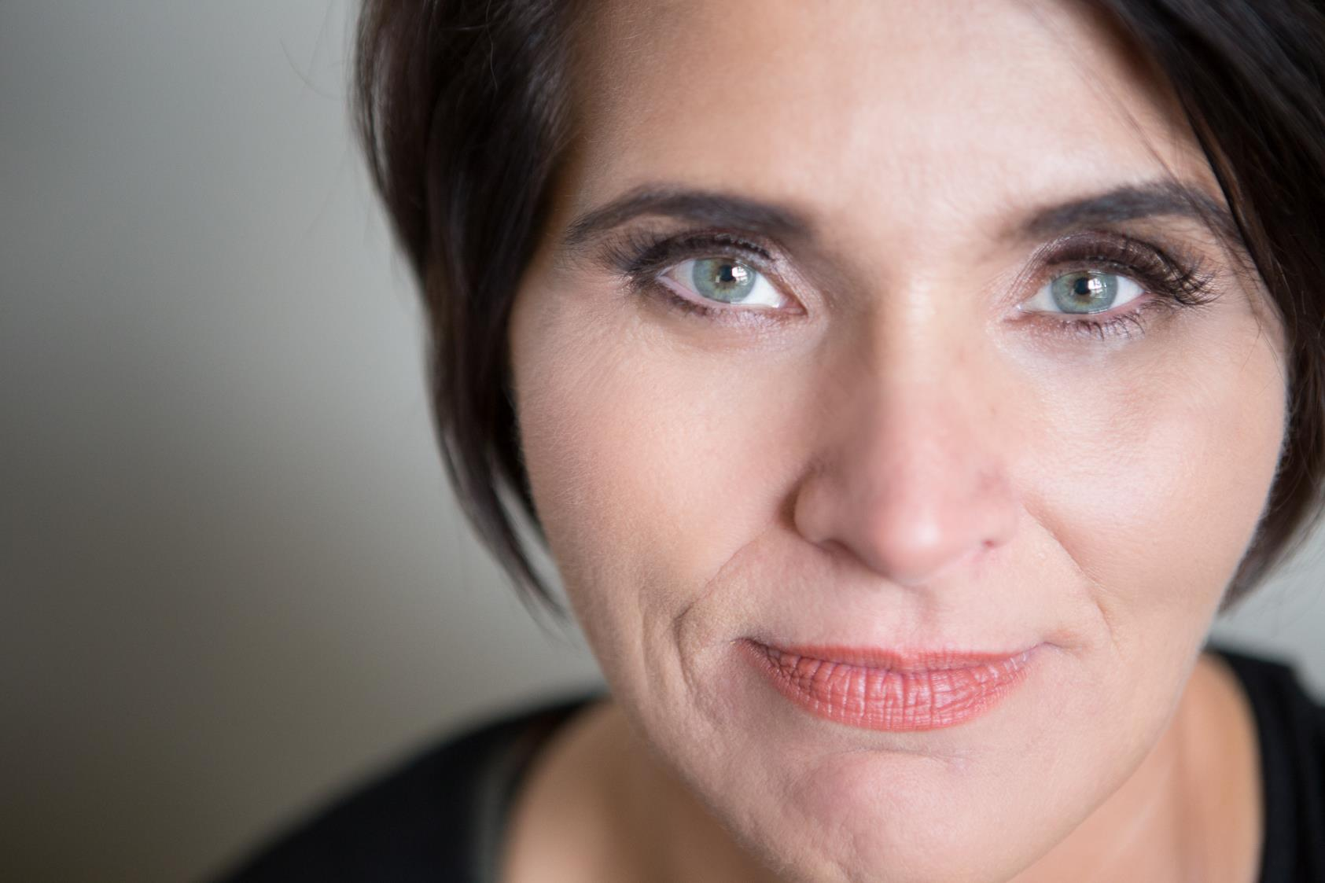

Slide 41
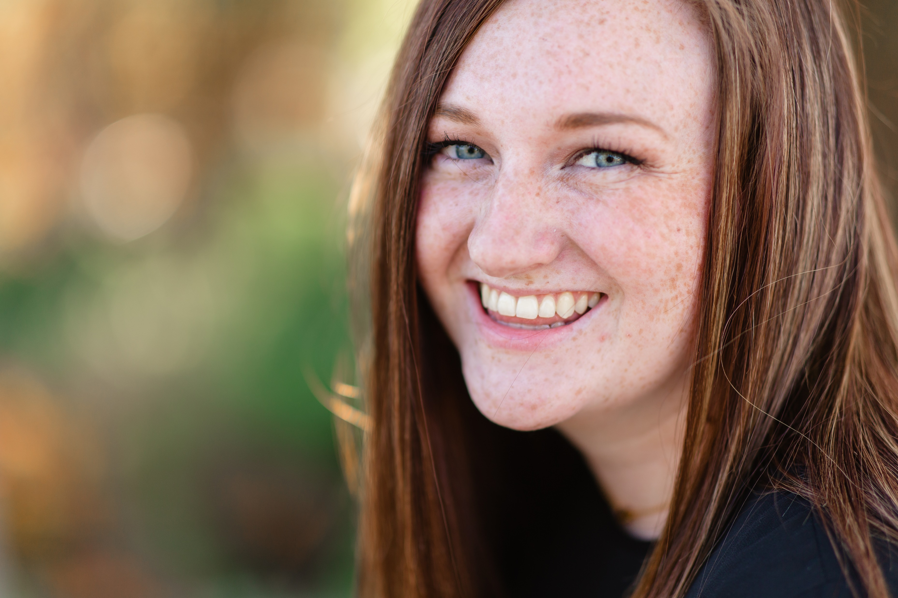

Slide 42
Try different points of view
Don’t settle for the first shot. Try different angles and points of view

Slide 43
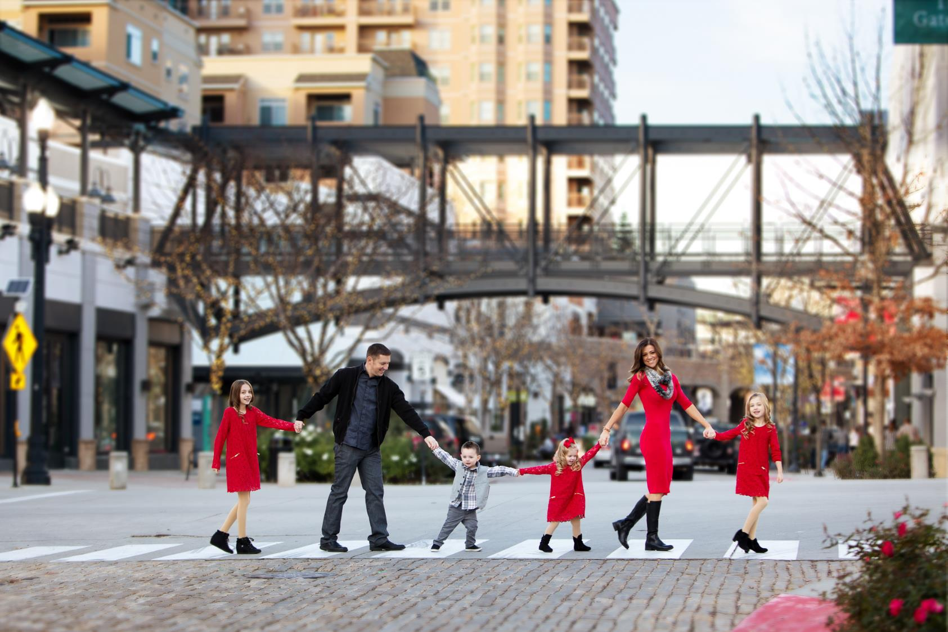

Slide 44
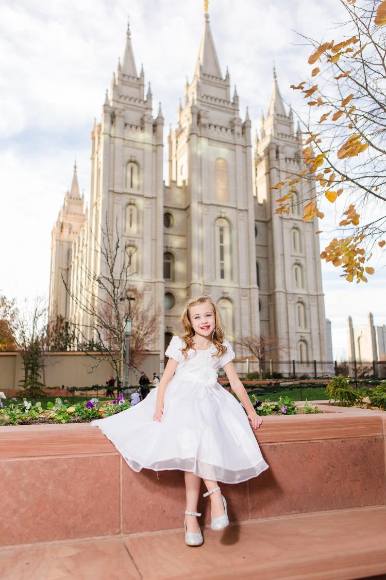

Slide 45
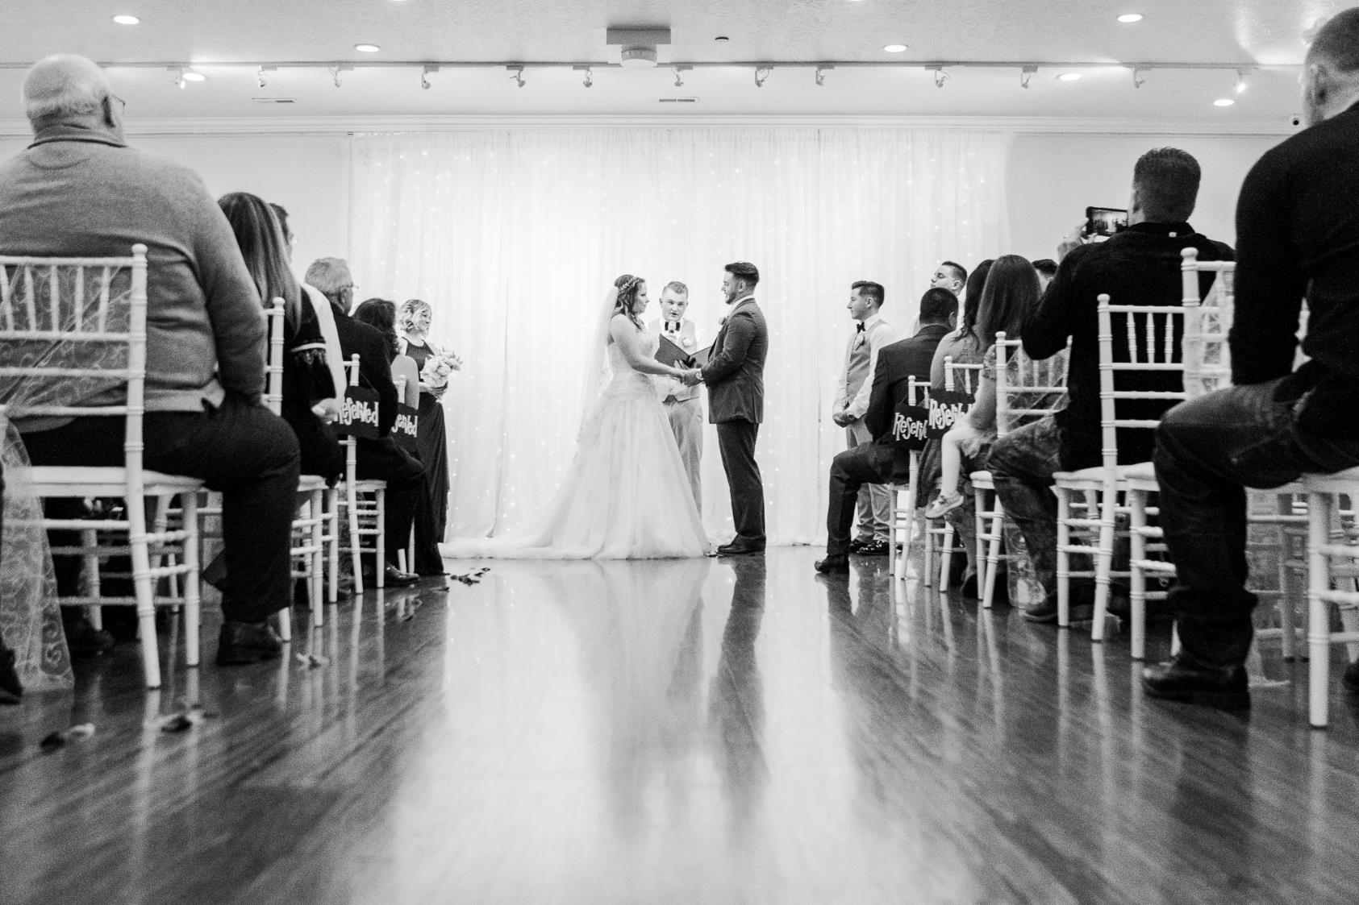

Slide 46
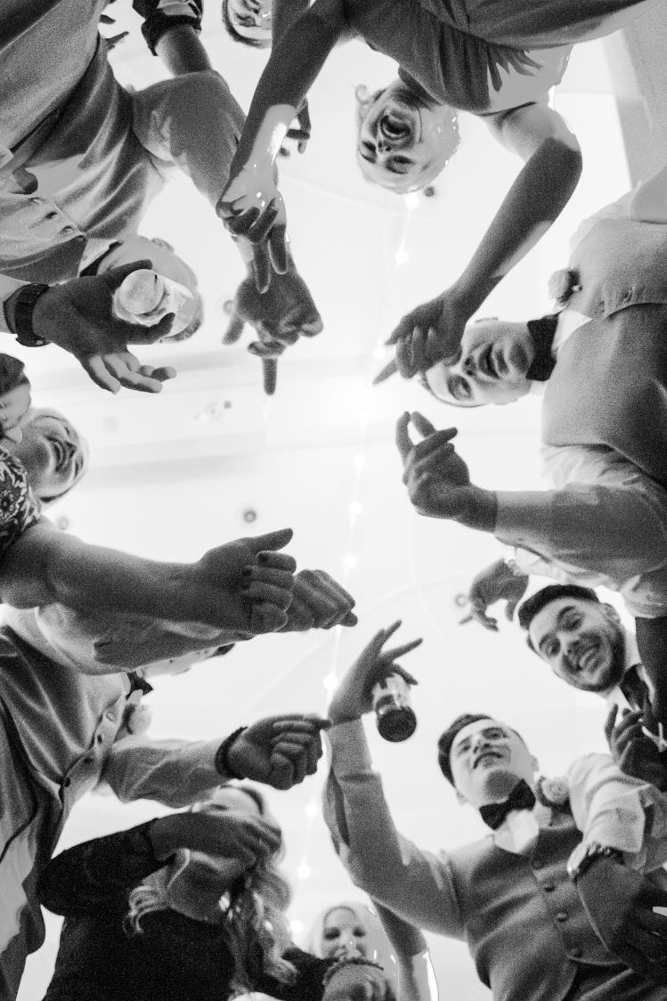

Slide 47
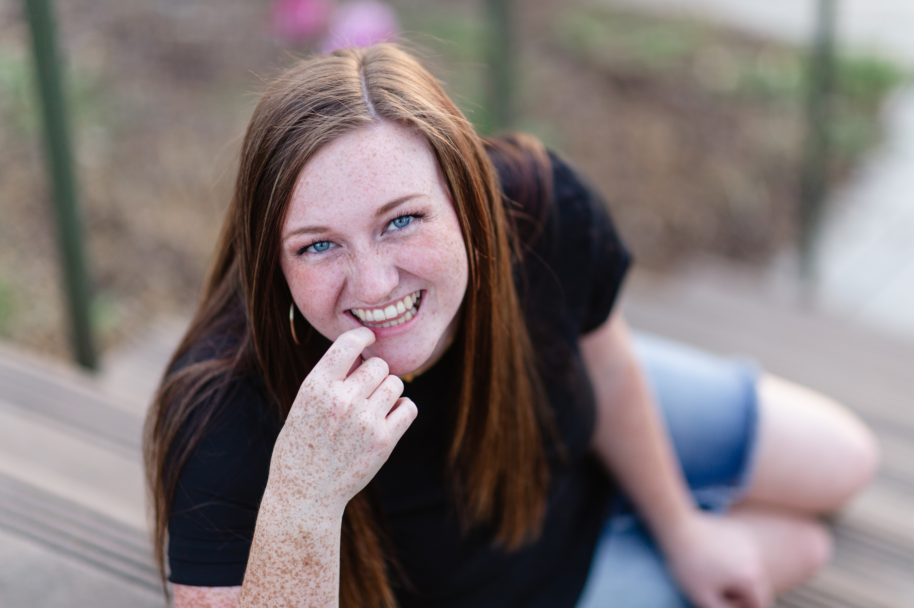

Slide 48
Light
Photography is painting with light

Slide 49
Main Light Sources
A main light source is the brightest light available.
Natural Light
Sun
Moon
Stars
Artificial Light
Flash
Incandecent (light bulbs)
Flourescent
Electronic Light (phones, tablets)
Christmas lights

Slide 50
Secondary Light Sources
This is where the magic happens!
A secondary light source is an additional light source that is usually not as bright as the main light source.
Examples are:
Open sky
Natural reflectors (Anything light and neutral in color that has the primary light source shining on it and bouncing back to the client)
Sidewalks
Dirt
Walls
Vans
Artificial reflectors
Fill flash

Slide 51
Direction of Light
Back
Front
Side
Top
Bottom

Slide 52
Quality of Light
Hard
Direct sun
Direct flash
Any light source that’s small and intense
Soft
Overcast sky
Window light
Shade from a building
Sunrise/sunset
Diffused light
Natural reflectors

Slide 53
What is best?
It depends on what look you’re going for.
Personally, I prefer the main light source to the back with soft, secondary light on the front.

Slide 54
Direct Sun Front Lighting
Pros
Cons
Evenly lit
No shadows
Flat lighting
People squinting
A lot of contrast
Dark shadows under the eyes if the sun is too high in the sky

Slide 55
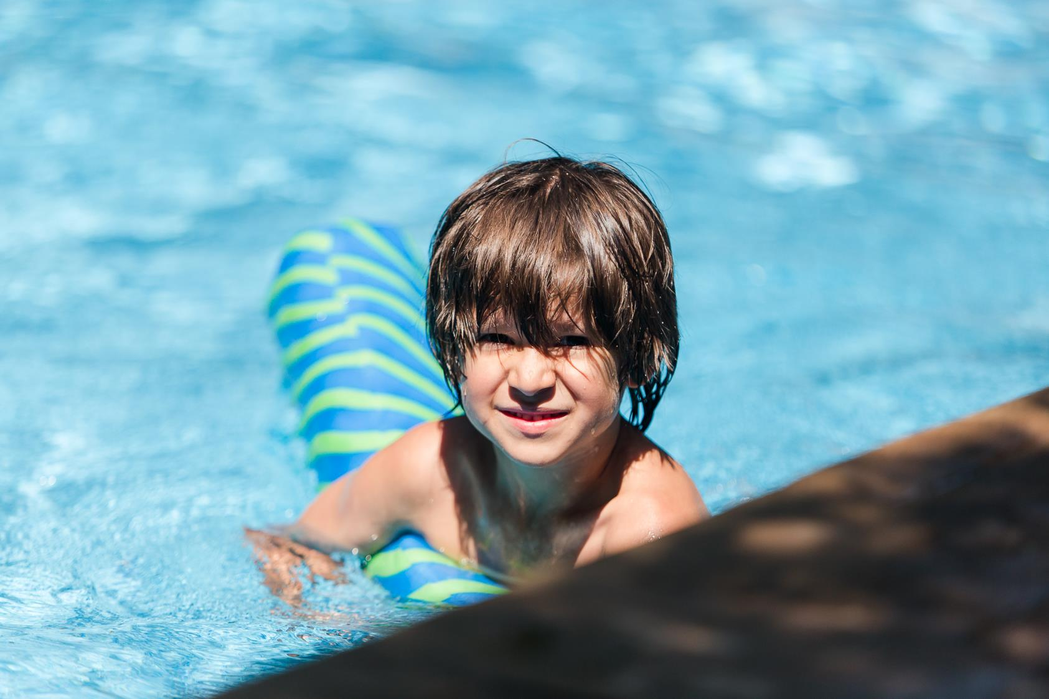

Slide 56
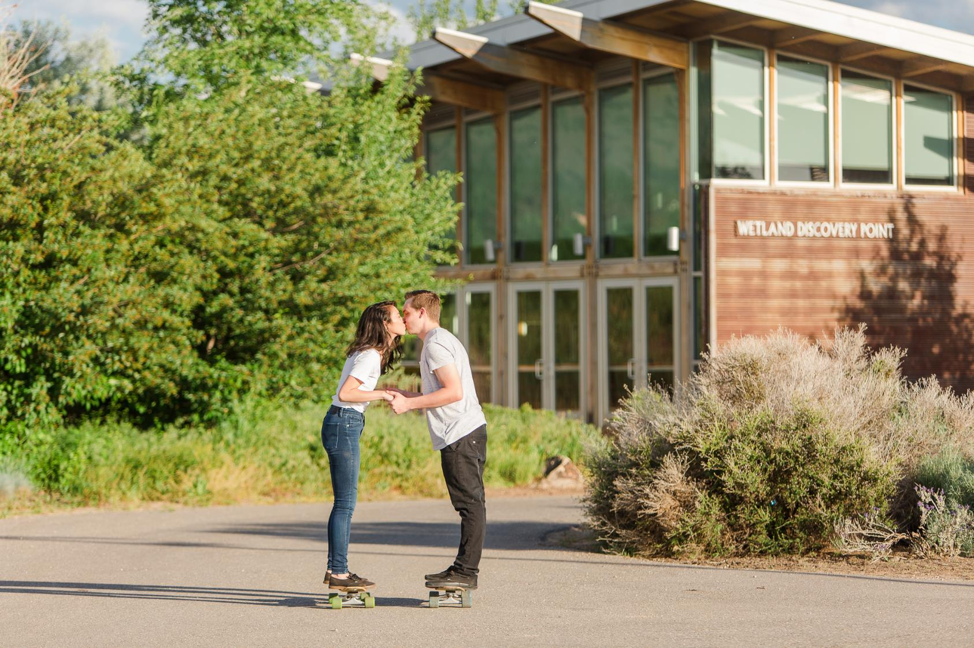

Slide 57
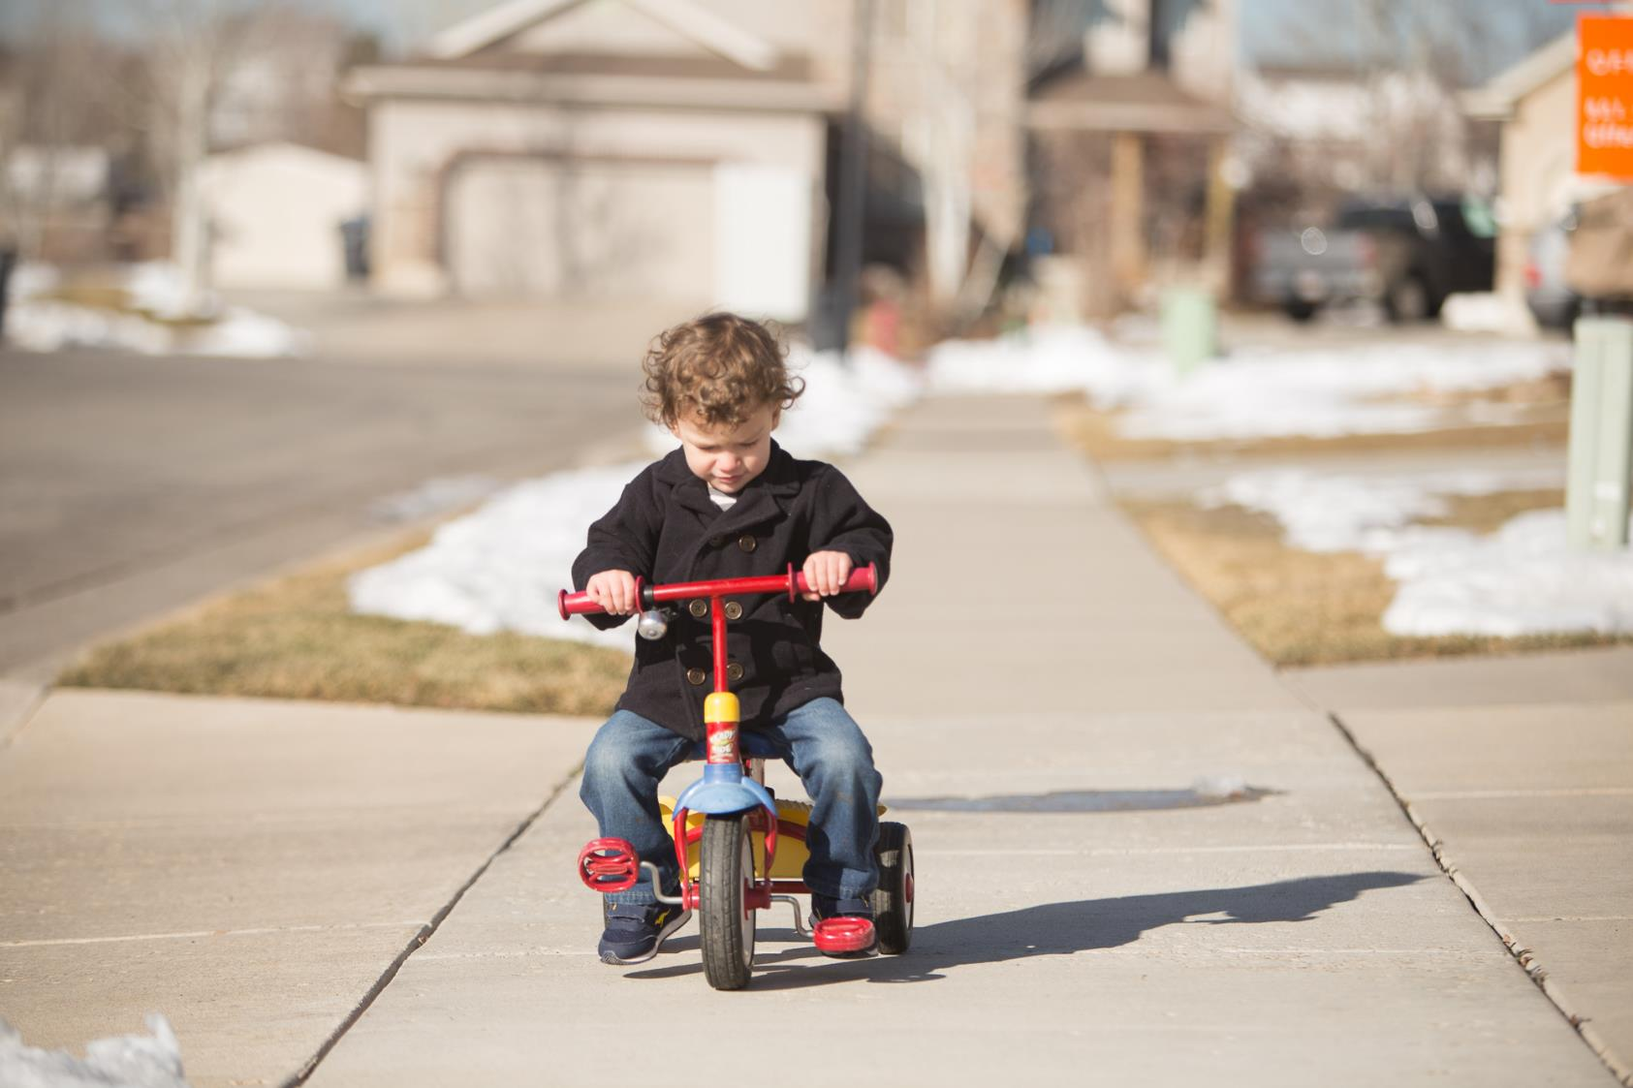

Slide 58
Direct Sun Back Lighting
How to work with it
Pros & Cons
Face subject toward their shadows.
Camera faces the light then turn just enough in either direction to avoid sun flare.
Find secondary light to light the face.
No squinting
Even lighting
Sun flare
Dark faces if you don’t have reflected light
Blown out skies

Slide 59
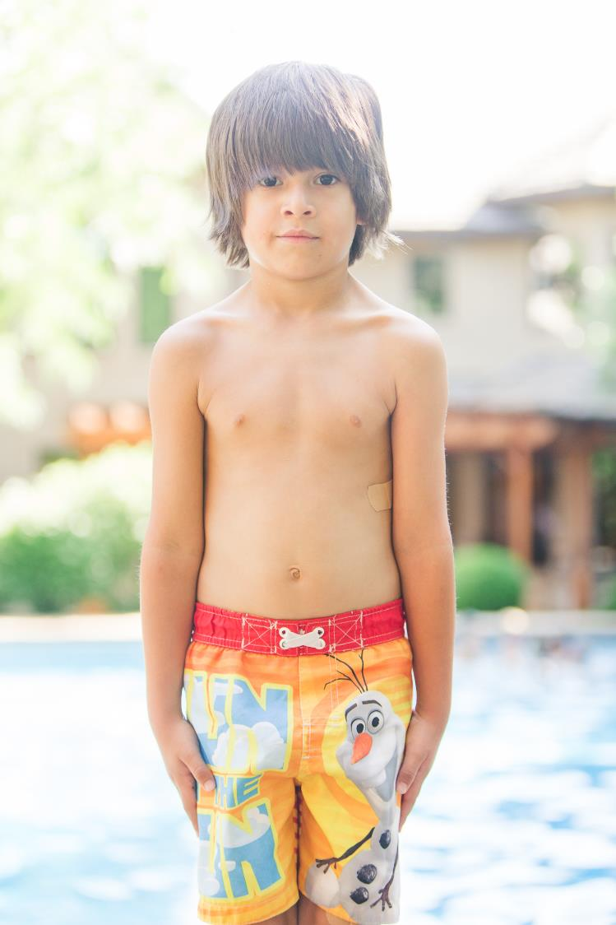

Slide 60
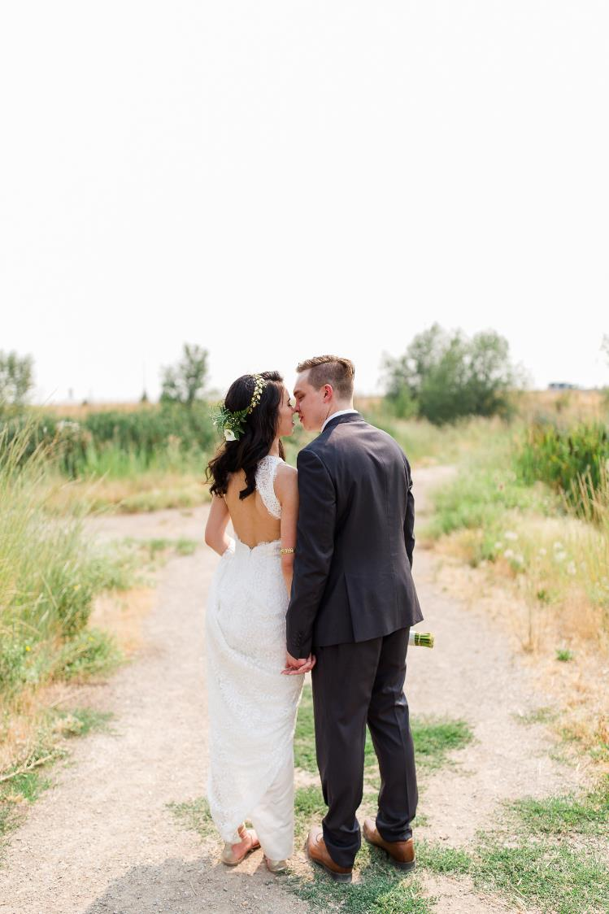

Slide 61
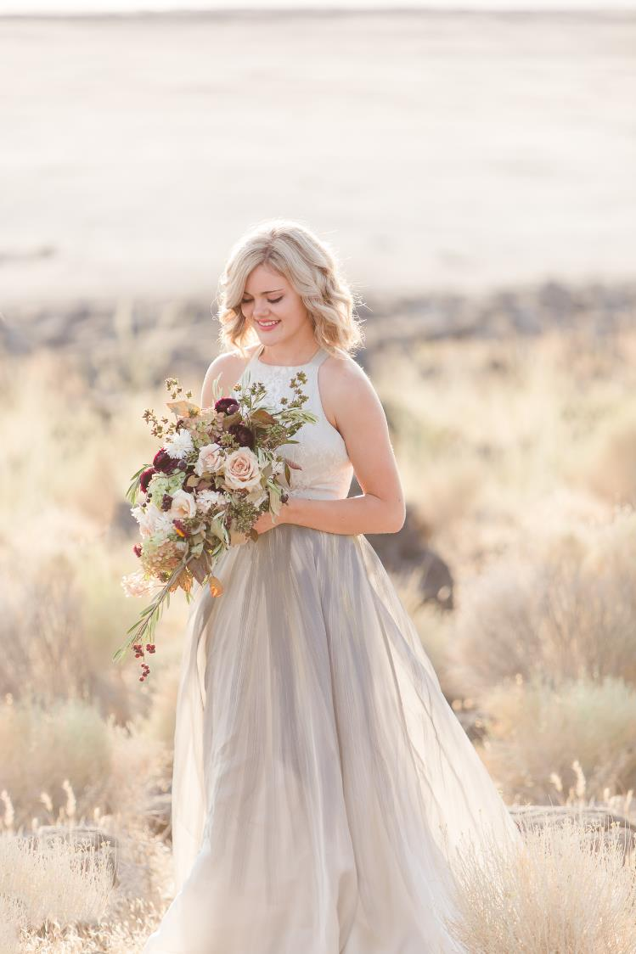

Slide 62
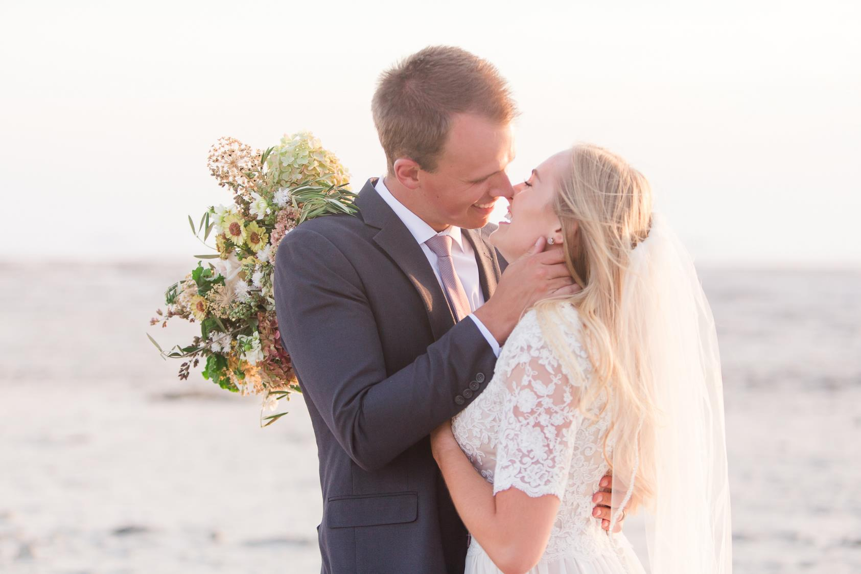

Slide 63
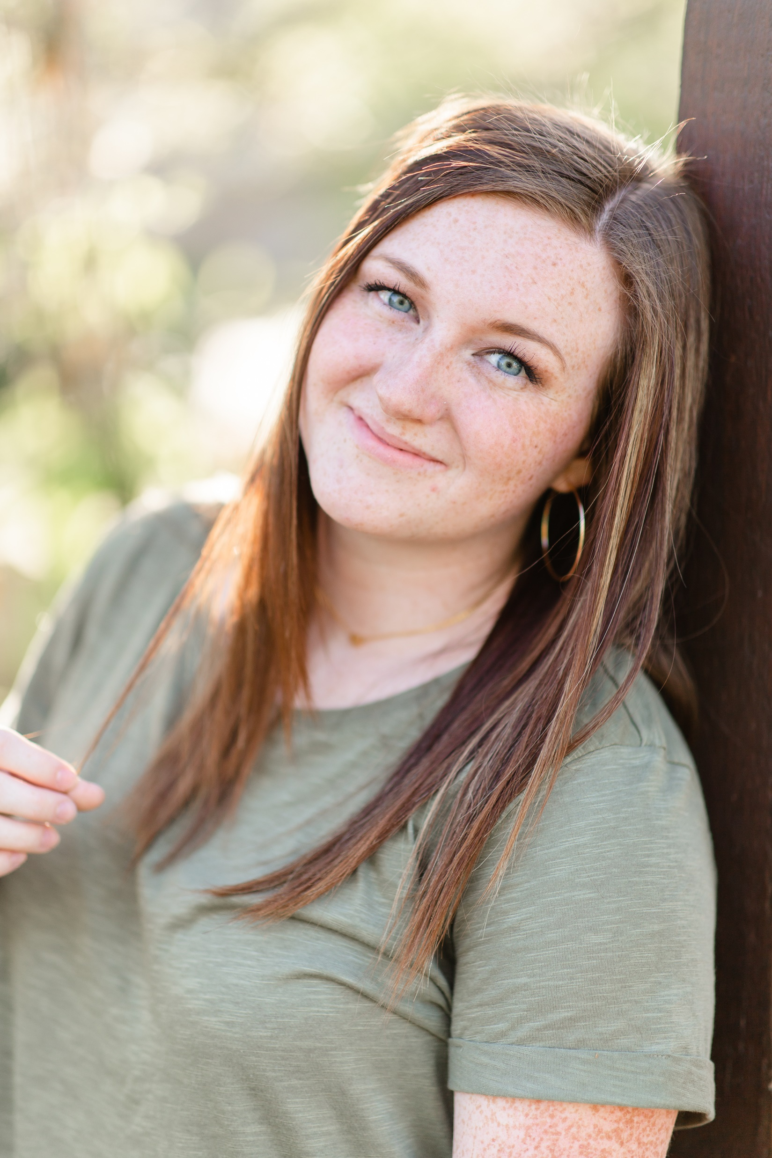

Slide 64
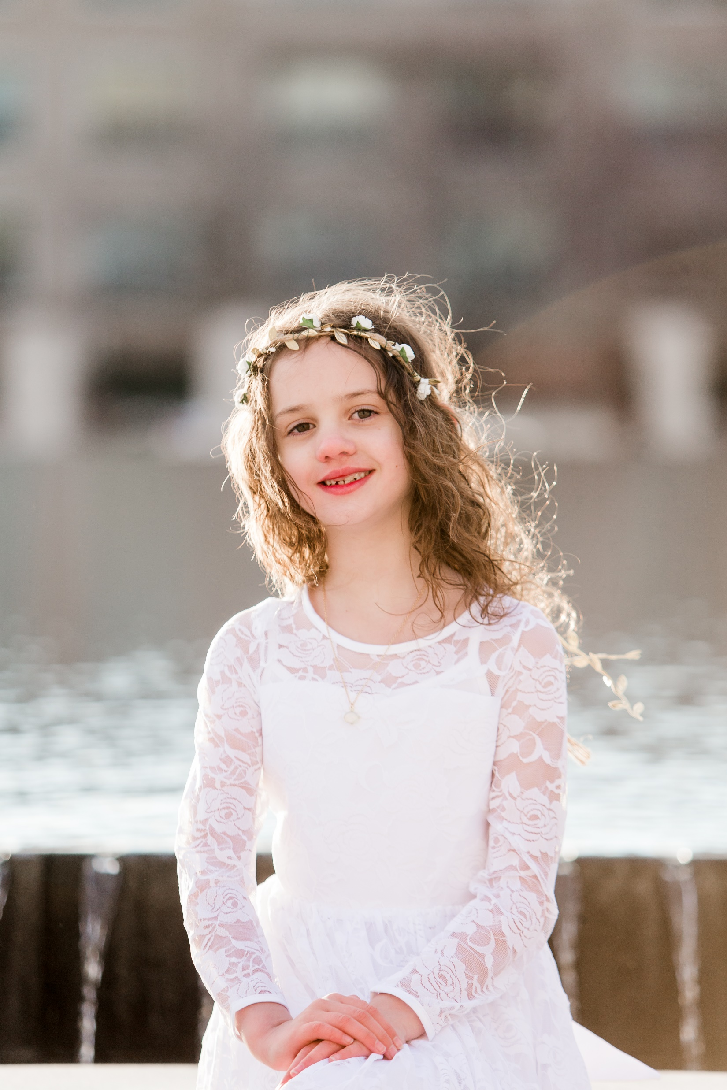

Slide 65
Diffused Back Light
Sunlight diffused through trees
Sunlight just peeking over the mountain
Sunrise and Sunset
Face subject away from the sun to get that rim light
Secondary light source to light subjects from the front

Slide 66
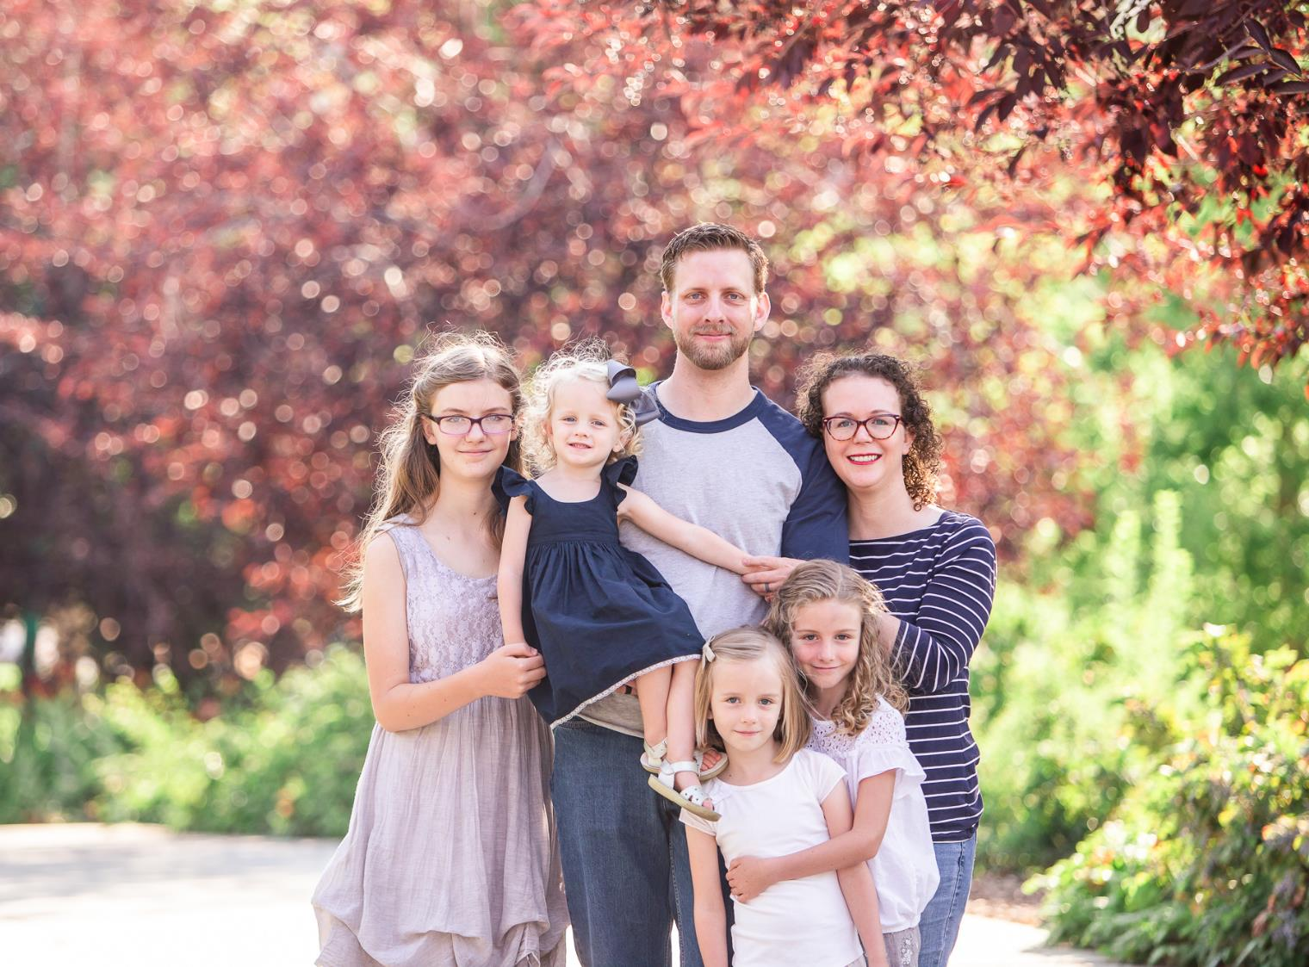

Slide 67
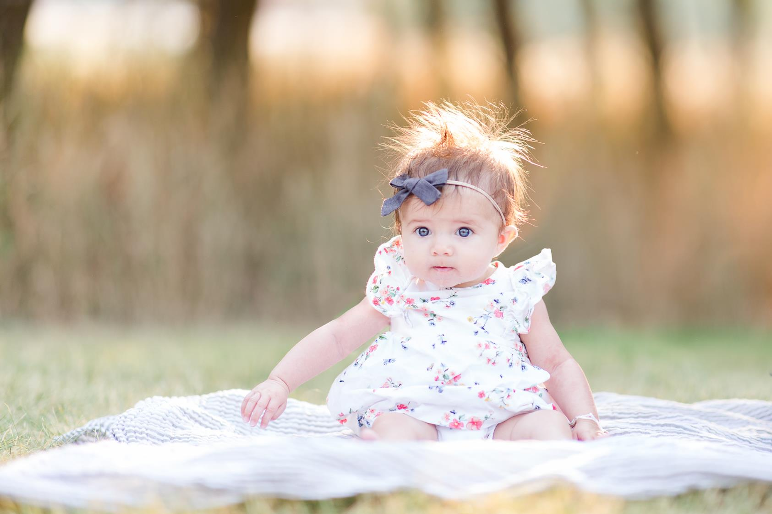

Slide 68
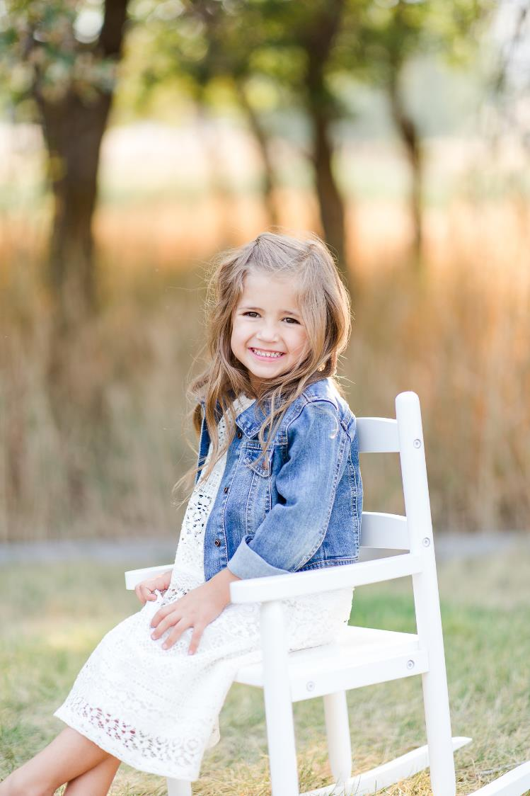

Slide 69
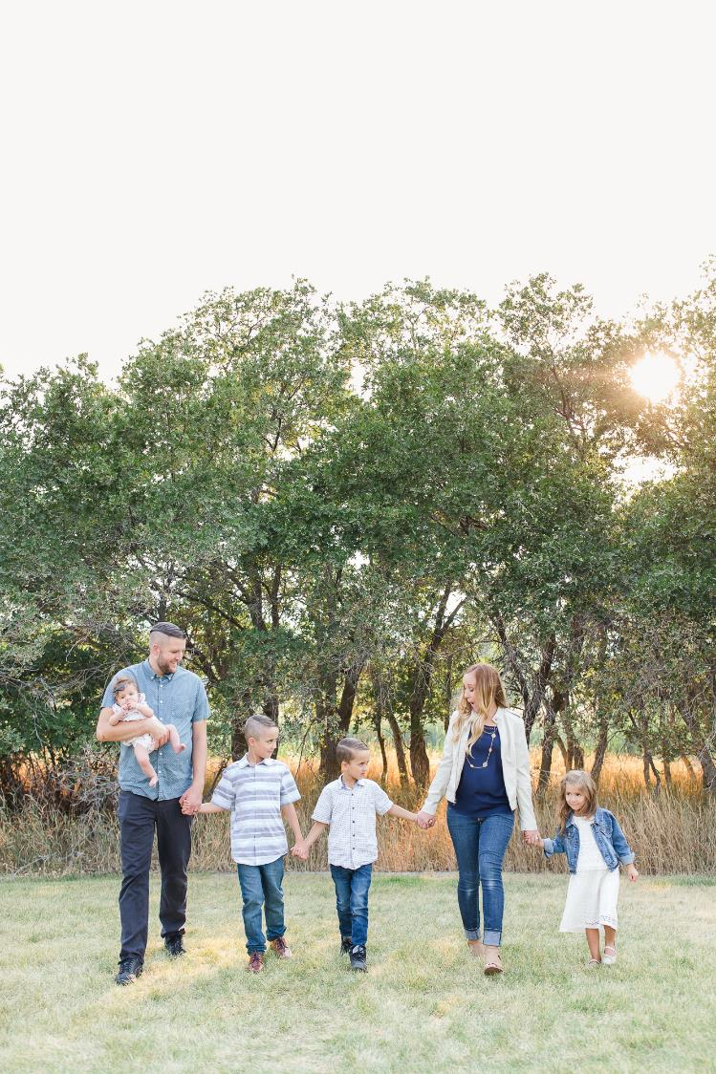

Slide 70
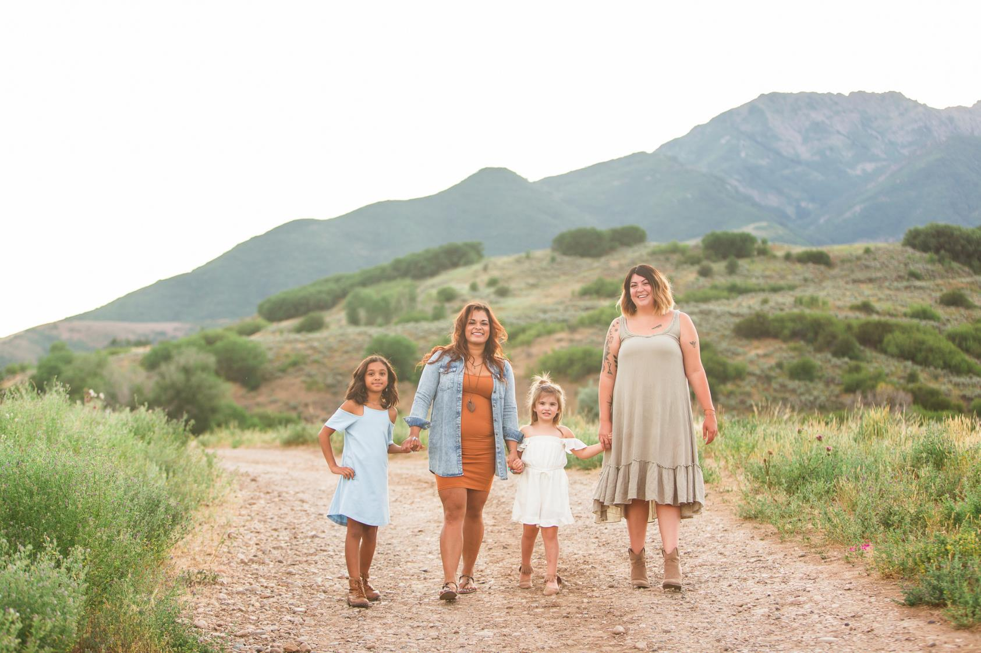

Slide 71
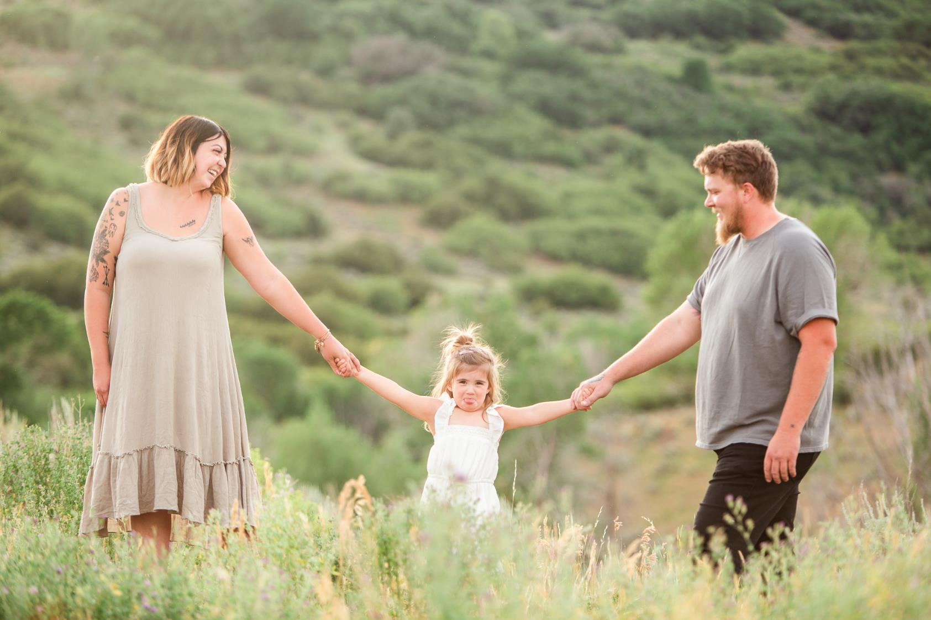

Slide 72
Darker ambience with Flash
If you prefer a darker background for a more moody look, you’ll likely need flash or a strong reflector as your secondary light for a backlit subject.

Slide 73
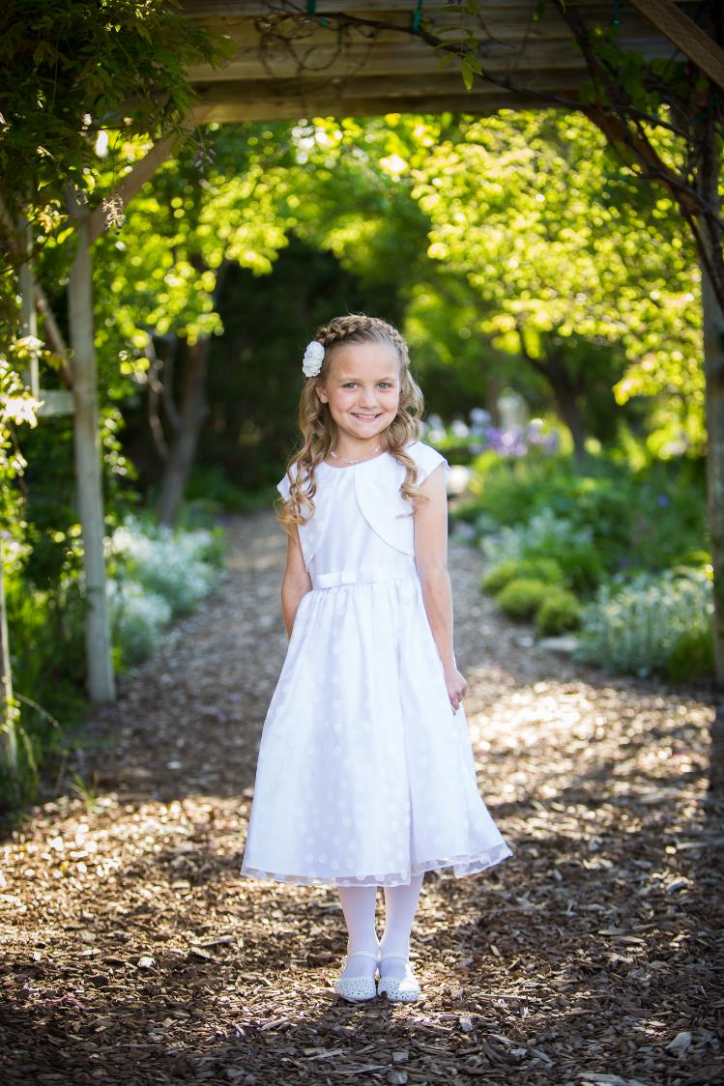

Slide 77
Diffused Main Light
How to use it
Types of diffused main light
Subject faces 45° toward brightest part of light (hand trick)
Cloudy skies
Light reflected into the shade
Light diffused through a man-made diffuser like a softbox or umbrella

Slide 81
Window & Porch Light
Window or porch light is probably one of the softest of the light sources.
For window light, turn off other lights in the room so you don’t get mixed light colors.

Slide 88
Color casts
Be weary of the reflected light causing a color cast such as light reflected off:
Grass
Colored buildings or other objects
Colored Umbrellas
Colored overhangs

Slide 89
Posing

Slide 90
What to know first
If you focus on flattering your subject’s features, they are free to focus on how they feel. The experience matters.
Truly candid moments usually aren’t very flattering. I prefer “coached” candid moments using prompts.
Use praise and encouragement when posing your subject.
Be specific when directing your subject.
Not “Turn a little”
Instead, “Turn your feet 45° to the right”
Mirror what you want

Slide 91
Getting genuine Smiles
Say something stupid, “Oh don’t mind me, just walking through the woods in a dress.”
Over-the-top energy and then make fun of yourself for it
Make them do something silly like, “giggle down your shoulder.” It feels silly so they’ll laugh for real.
Incorporate movement (swishing a dress, walking forward, etc.)
Use “prompts” (my new favorite)
Kind of like having people acting out a story
Couples: “Whisper your favorite food in her ear.”
Friends: “Look at your favorite friend.”
Family: “Everyone look at the person with the loudest farts.”

Slide 92
Masculine Posing
Observe how mannequins look in department stores
Shoulders square to camera
Feet shoulder-width apart
One foot a little in front of the other
Hands in pockets
Lean on back leg, bend front knee a little
Lean forward, bending at the waist, toward the camera
Chin forward and down
We’re basically going for small waists and broad shoulders

Slide 93
Feminine Posing
Toes 45 degrees to right or left of camera
Toes together
Pop front knee (makes hips go back)
Twist shoulders back to camera at torso
Space between arms and body
Lean forward, bending at waist, toward camera
Chin forward and down
We’re shooting for small waists, hips and feminine curves

Slide 94
3 phases of posing Couples
3. Head
2. Arms
1. Feet

Slide 95
The Feet
Girl and guy face each other
Guy faces forward, girl faces guy
Girl’s back to guy’s chest
Girl and guy forward, but girl’s body is slightly behind guy’s.
Guy sits with feet out front and knees bent. Girl sits 45° and leans into guy’s chest.

Slide 96
The Arms
For Her
For Him
Hold on to:
His arm
His hand(s)
His waist
His neck
His clothing
Her dress
Her hair
Her clothing accessory (scarf, jacket, hat, etc.)
An object (like a bouquet, scarf, hat, etc)
Hands on hips
Hands in pockets
Hang hands (with elbows slightly bent)
Both arms around girl’s waist
One arm around waist, the other in pocket
Both hands in pockets
One “escort” arm and one hand in pocket
Holding hands with girl
One hand on shoulder/bicep/arm

Slide 97
The Head
For Her
For Him
Looking at camera
Looking at him
Looking at someone else
Looking just off camera
Looking down
Forehead to forehead
Kissing
Looking over shoulder
Looking at camera
Looking at her
Looking at someone else
Looking just off camera
Nose to temple
Kissing cheek/temple
Forehead to forehead

Slide 103
Hands in pockets

Slide 104
3 or more people
When posing 3 or more people:
Create triangular or diamond shapes with heads and bodies
Stagger head heights

Slide 105
Still posing couples just like I would if it were just the two of them

Slide 110
Posing Prompts for Young Families
Games are a great way to get natural expressions from kids
Play “airplane” (dad flies kids in air)
Twirling
Tickle mom and dad
Wiggle freeze
Simon Says
Eskimo kisses
Run and hug

Slide 114
Next Class
Meet at the main Weber State University Ogden campus at the duck pond. Park in any lot except A1

Slide 115
Homework
Practice photographing people using the lighting techniques we’ve discussed.
If you can find a willing subject, practice some of the posing techniques we’ve talked about. Try to use motion and prompts to get natural expressions.

